Slide 1
ARTIQ
gateware:RTIO
4/7/2020

Slide 2
rtiox4_clk : 500MHz
clk200 : 200MHz (from SiT9102AI-243N25E200.00000)
rtio_clk = rio_phy_clk : 125MHz
rtio_clk = rio_clk : 125MHz
SDRAM
rsys_clk : 125MHz (from clk200)
gateware(kc705.py)
MiniSoC
AMPSoC
Timer
BaseSoC
KernelCPU
GPIOOut
SoCSDRAM
SoCCore
GPIOTristate
mor1kx
mor1kx
RTIO(add_rtio)
ttl_clock_la32_p
ttl_simple.ClockGen
_RTIOCRG
ad9914dds
MonInj
TSC
BUFG
dds.AD9914
sdcrad_spi_33
SPIMaster
PLLE2_ADV
Core
DMA
rtiox4_clk = rio_phy_clk
led
ttl_serdes_simple.Output
SED
1 0
OutputDriver
Gates
FIFOs
LaneDistributor
rtio_clk = rio_phy_clk
ttl
ttl_serdes_7series.Output
KernelInitiator
rtio_clk = rio_clk
ttl
ttl_serdes_7series.InOut
InputCollector
rsys_clk
Analyzer

Slide 3
rtiox4_clk : 500MHz
clk200 : 200MHz (from SiT9102AI-243N25E200.00000)
rtio_clk = rio_phy_clk : 125MHz
rtio_clk = rio_clk : 125MHz
SDRAM
rsys_clk : 125MHz (from clk200)
gateware(kc705.py)
MiniSoC
AMPSoC
Timer
BaseSoC
KernelCPU
GPIOOut
SoCSDRAM
SoCCore
GPIOTristate
mor1kx
mor1kx
RTIO(add_rtio)
ttl_clock_la32_p
ttl_simple.ClockGen
_RTIOCRG
ad9914dds
MonInj
TSC
BUFG
dds.AD9914
sdcrad_spi_33
SPIMaster
PLLE2_ADV
Core
DMA
rtiox4_clk = rio_phy_clk
led
ttl_serdes_simple.Output
SED
1 0
OutputDriver
Gates
FIFOs
LaneDistributor
rtio_clk = rio_phy_clk
ttl
ttl_serdes_7series.Output
KernelInitiator
rtio_clk = rio_clk
ttl
ttl_serdes_7series.InOut
InputCollector
rsys_clk
Analyzer

Slide 4
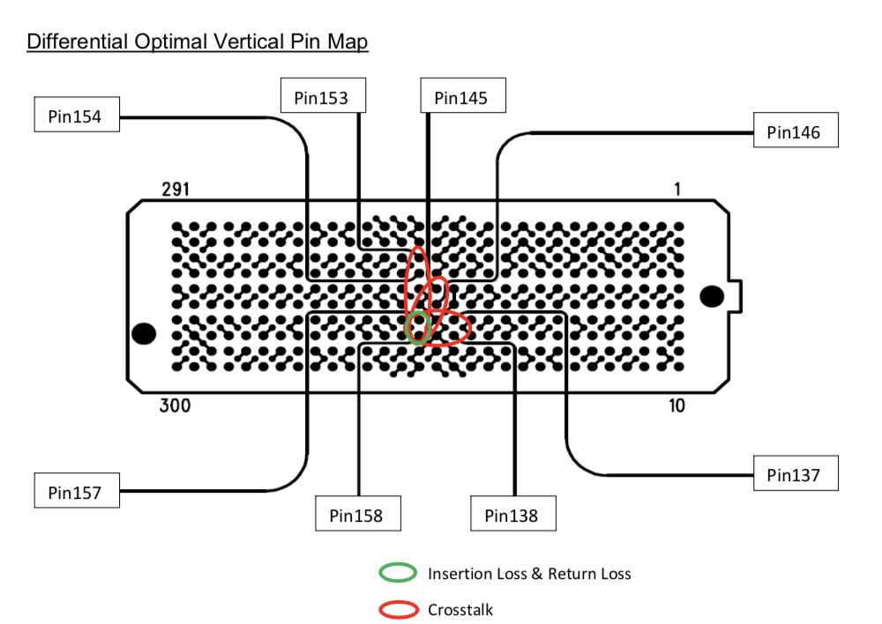
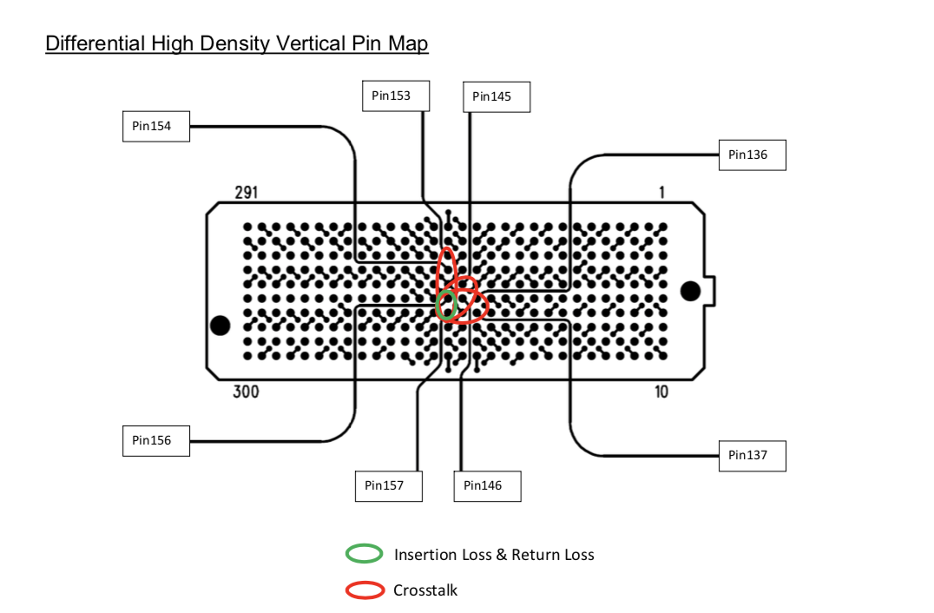
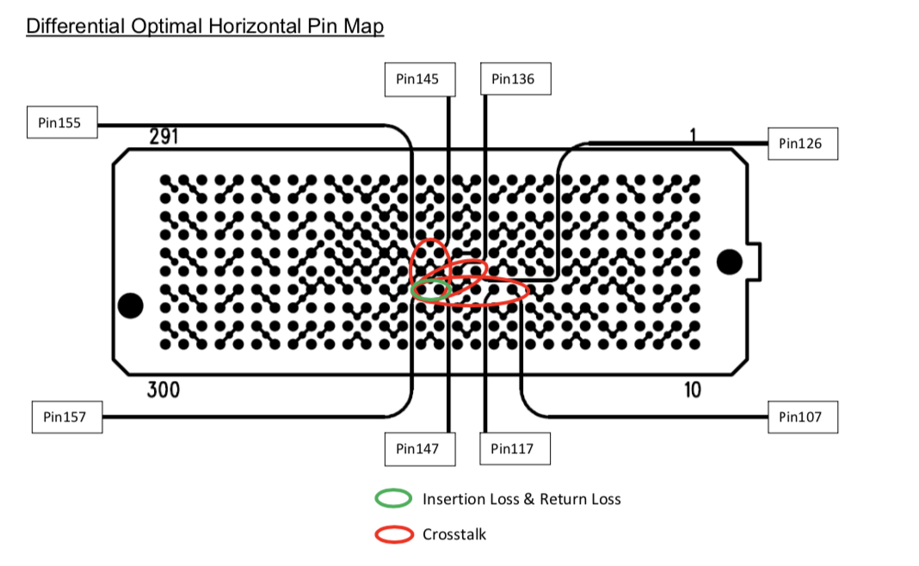
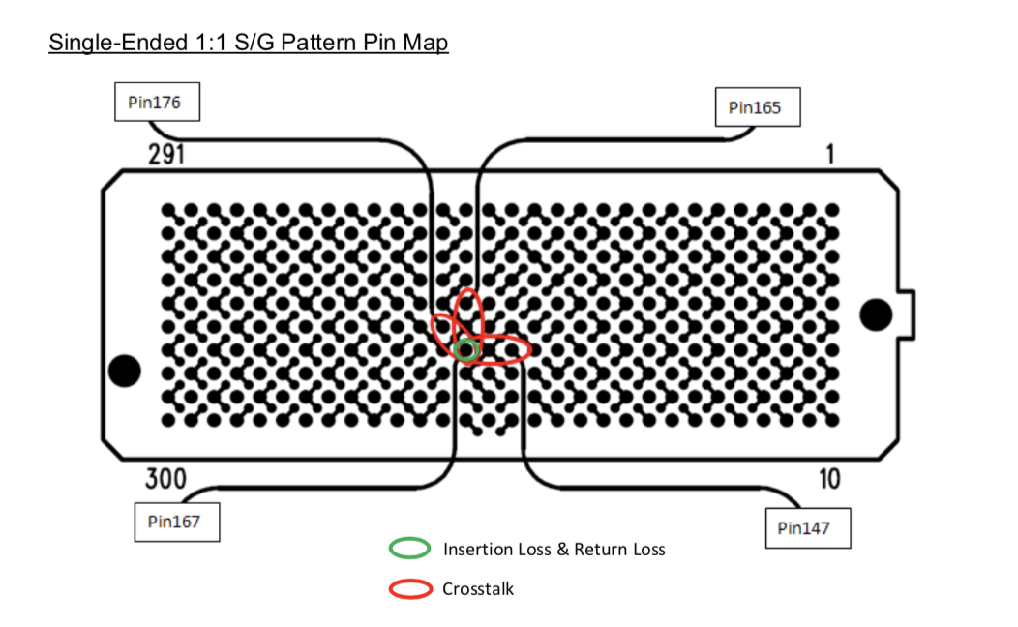
Things to do
What Vertical, Horizontal mean?
What LVTTL, LVCMOS exactly mean?
Numerical value of slew rate

Slide 5
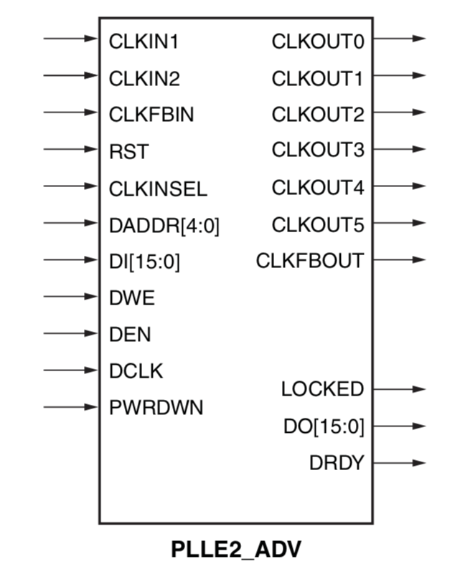
PLLE2_ADV
reference clock
output of modified clock
input of feedback clock
select refernce clock
output of feedback clock
input of dynamic reconfiguration
(ARTIQ gateware don’t use this)
select mode which decrease output power not using
whether PLL is stabilized
output of dynamic reconfiguration
(ARTIQ gateware don’t use this)

Slide 6
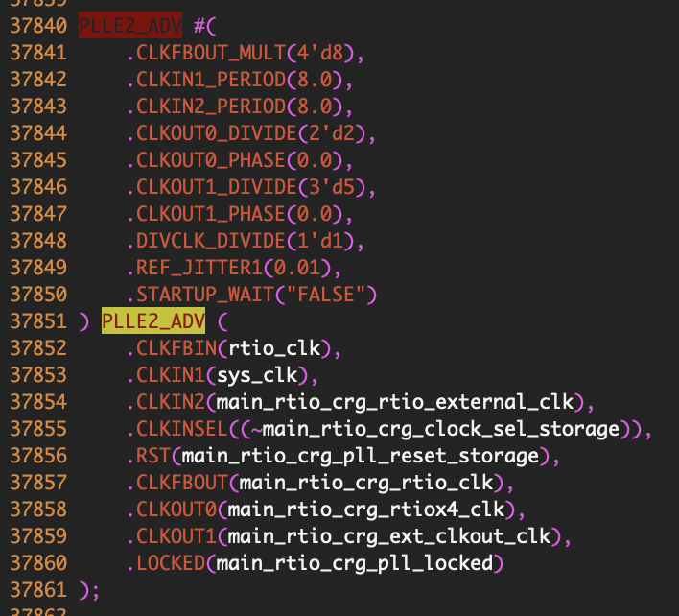
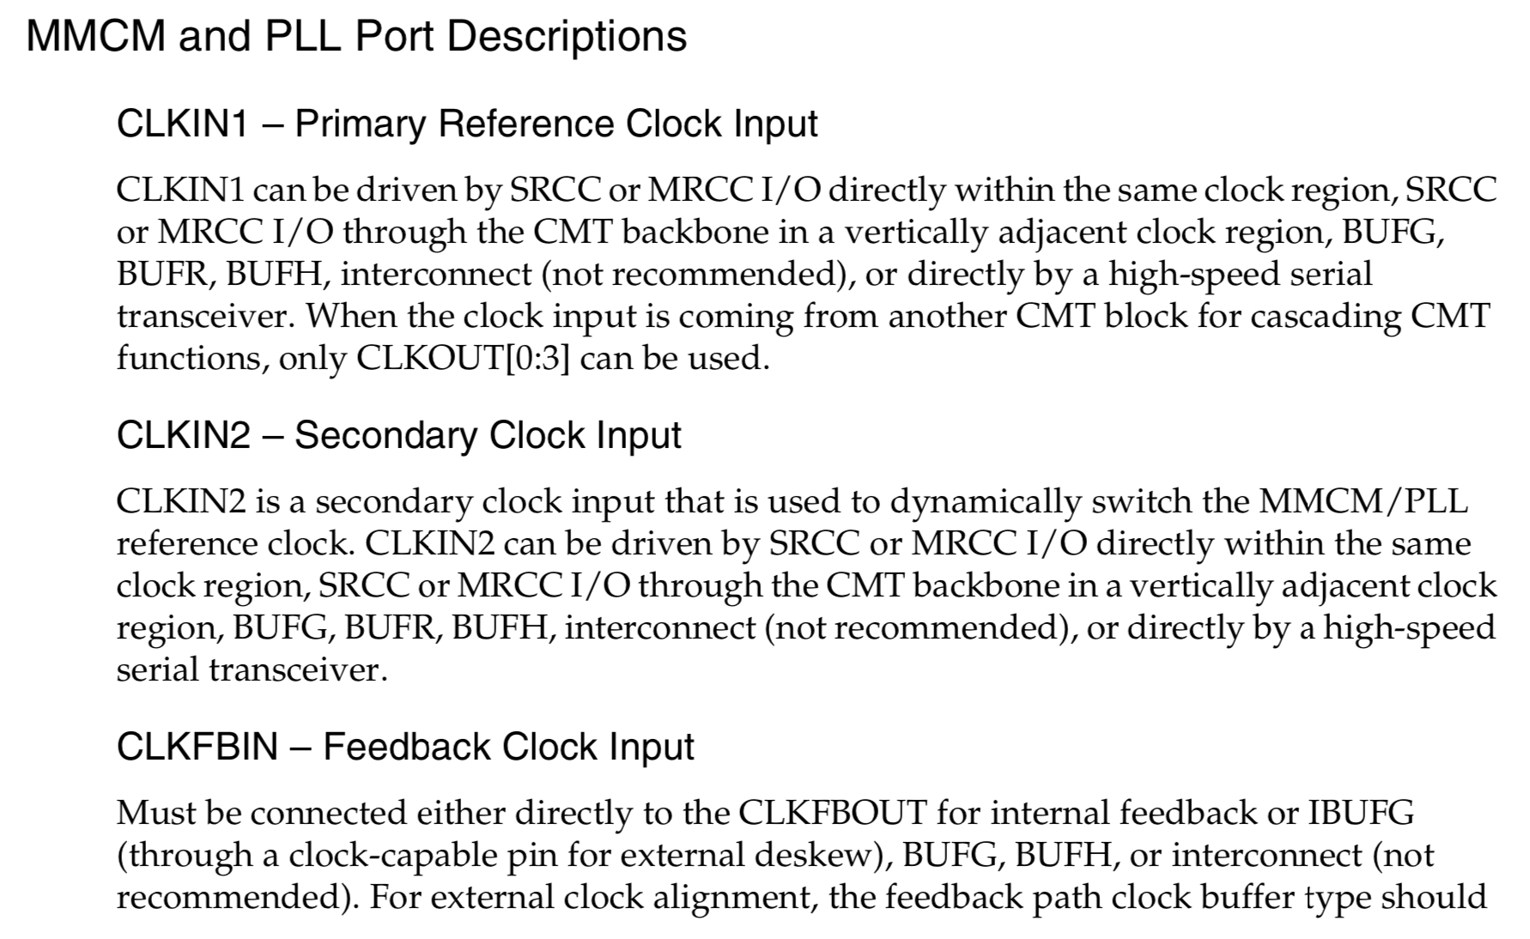
PLLE2_ADV in Verilog
set all output clock to be multiplied by 8
first reference clock duration is equal to 8[ns]
divide output clock0 duration by 2
clock0 duration
= input clock * 8/2
divide all of output clock by 1
tolerated error for simulation
don’t wait during the configuration start-up for PLL to lock

Slide 7
RTIO clock
tsc.corase_ts[60:0]
fine_ts[2:0]
time for output occur
8[ns] scale
(125 MHz)
select signal form to release
1[ns] scale
(500MHz*2)
TSC
SDRAM
Total 29 of ports
depth of fifo = 128
Implement network sorting
ttl_serdes_7series.InOut
DMA
Lane
Distributor
FIFO
gates
ttl_serdes_7series.InOut
FIFO
gates
ttl_serdes_7series.InOut
ttl_serdes_7series.Output
FIFO
gates
ttl_serdes_7series.InOut
FIFO
gates
ttl_serdes_7series.InOut
0 1
MUX
ttl_serdes_7series.InOut
cri
FIFO
gates
ttl_serdes_simple.Output
FIFO
gates
spi2.SPIMaster
spi2.SPIMaster
FIFO
gates
spi2.SPIMaster
FIFO
gates
dds.AD9914

Slide 8
SED
LaneDistrubutor
FIFOs
gates
output_driver
output
input
output
input
output
we
we
re
re
valid
valid
writable
writable
readable
readable
replace_occured
replace_occured
seqn[11:0]
seqn[11:0]
seqn[11:0]
seqn[11:0]
nondata_replace_
occured
nondata_replace_
occured
payload
payload
payload
payload
seqn[11:0]
seqn[11:0]
channel[4:0]
channel[4:0]
channel[4:0]
channel[4:0]
channel[4:0]
payload
timestamp[63:0]
timestamp[63:0]
timestamp[63:0]
timestamp[63:0]
timestamp[63:0]
channel[4:0]
address[7:0]
address[7:0]
address[7:0]
address[7:0]
address[7:0]
timestamp[63:0]
data[31:0]
data[31:0]
data[31:0]
data[31:0]
data[31:0]
address[7:0]
data[31:0]

Slide 9
SED
LaneDistrubutor
FIFOs
gates
output_driver
output
input
output
input
output
we
we
re
re
valid
valid
writable
writable
readable
readable
replace_occured
replace_occured
seqn[11:0]
seqn[11:0]
seqn[11:0]
seqn[11:0]
nondata_replace_
occured
nondata_replace_
occured
payload
payload
payload
payload
seqn[11:0]
seqn[11:0]
channel[4:0]
channel[4:0]
channel[4:0]
channel[4:0]
channel[4:0]
payload
timestamp[63:0]
timestamp[63:0]
timestamp[63:0]
timestamp[63:0]
timestamp[63:0]
channel[4:0]
address[7:0]
address[7:0]
address[7:0]
address[7:0]
address[7:0]
timestamp[63:0]
data[31:0]
data[31:0]
data[31:0]
data[31:0]
data[31:0]
address[7:0]
data[31:0]
Sort signal with “channel” and “valid” value, and implement output physically if it is adequate
& Investigate whether collision error occurs
Determine whether underflow, sequence error occurs
Store data came from “LaneDistributor”
& Release data depending on “gates” signal(“re”)
Make “re” HIGH if timestamp is equal to real clock
& Make “valid” HIGH if timestamp is equal to real clock

Slide 10
ttl_serdes_7series.Output_8X
_SerdesDriver
rtlink = rtlink.Interface
rio_phy_clk
OInterface = o
serdes_o[7:0]
rio_phy_clk
previous_data
8
stb
stb
1 0
data[0:0]
data[0]
data
fine_ts[2:0]
fine_ts[2:0]
override_en
1 0
busy
8
delay = 0
8
1 0
serdes = _OSERDESE2_8X
1 0
o[7:0]
override_o
x8
x8
i[7:0]
override_en
edges[fine_ts]
0 8’b11111111
1 8’b11111110
2 8’b11111100
3 8’b11111000
4 8’b11110000
5 8’b11100000
6 8’b11000000
7 8’b10000000
pad_o
override_o
t_out
t_in

Slide 11
More precise length of HIGH, LOW signal
Remember last signal
Set whether output signal is HIGH or LOW
ttl_serdes_7series.Output_8X
Decide whether change for signal enable
_SerdesDriver
rtlink = rtlink.Interface
rio_phy_clk
OInterface = o
serdes_o[7:0]
rio_phy_clk
previous_data
8
stb
stb
1 0
data[0:0]
data[0]
data
fine_ts[2:0]
fine_ts[2:0]
override_en
1 0
busy
8
delay = 0
8
1 0
serdes = _OSERDESE2_8X
1 0
o[7:0]
override_o
x8
x8
i[7:0]
override_en
edges[fine_ts]
0 8’b11111111
1 8’b11111110
2 8’b11111100
3 8’b11111000
4 8’b11110000
5 8’b11100000
6 8’b11000000
7 8’b10000000
pad_o
override_o
t_out
t_in
Output data
Override signal
Whether to override
Signal to be released

Slide 12
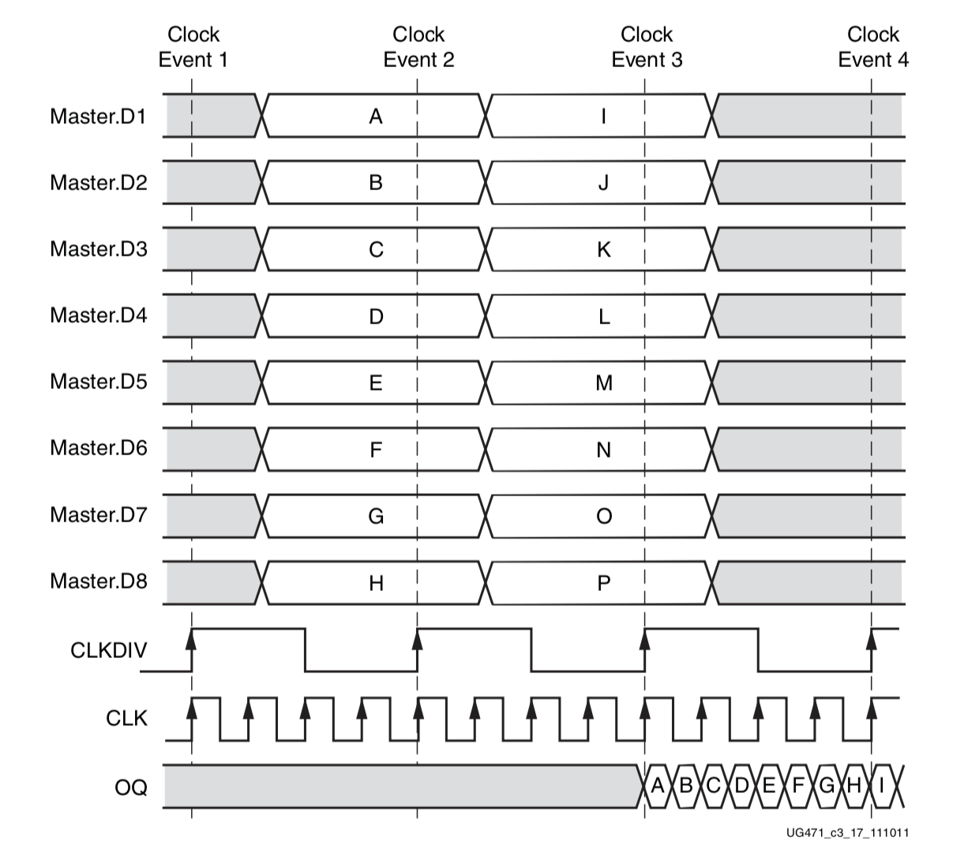
_OSERDESE2_8X
i_D1 = o[0]
i_D2 = o[1]
i_D3 = o[2]
i_D4 = o[3]
i_D5 = o[4]
i_D6 = o[5]
i_D7 = o[6]
i_D8 = o[7]
o[7:0]
OSERDESE2
8
i_D1-8
o_OQ
i_CLK = “rtiox4”
o_TQ
pad
pad_o
i_CLKDIV = “rio_phy”
i_RST=“rio_phy”
t_out
i_TCE = 1’b1
DDR
BUF
invert->8’b11111111
else8’b00000000
D1 appear first
i_OCE = 1’b1
t_in
i_T1
D1
D2
D3
D4
D5
D6
. . .
t
Physical output pin
parallel to serial converter

Slide 13
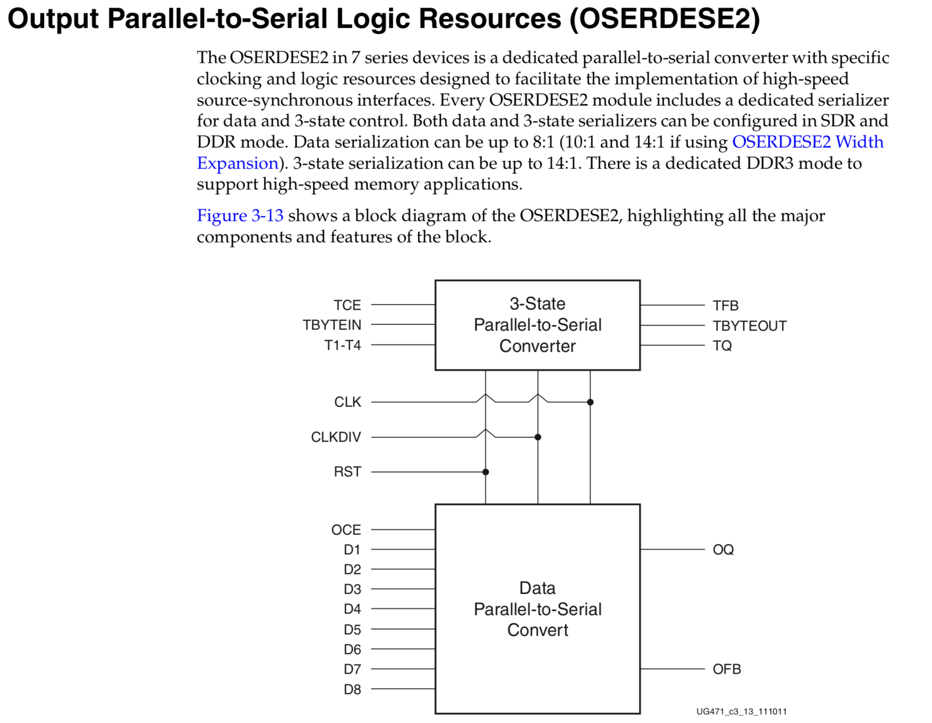
OSERDESE2
3-state output clock enable
byte group 3-state input
byte group 3-state output
3-state parallel input
serial 3-state output
output clock
input clock
asynchronous reset & should be deasserted synchronously to CLKDIV
output clock enable
serial output
parallel input

Slide 14
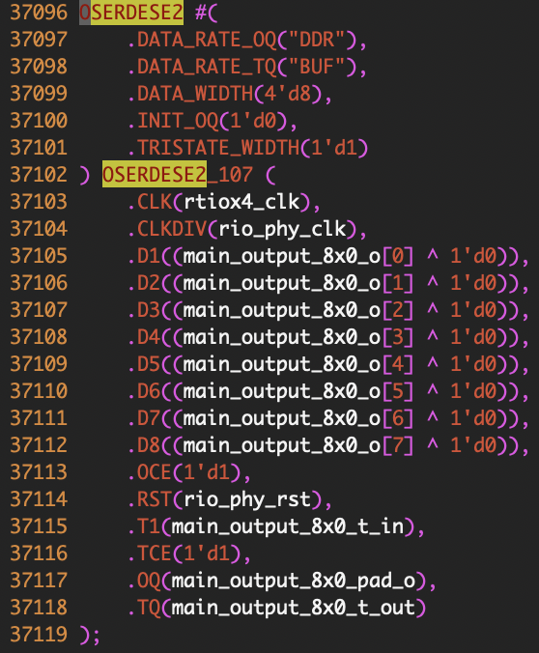
OSERDESE2 in Verilog
set output data rate (Double Data Rate)
=> there are SDR, DDR mode
set tristate output data rate (Double Data Rate)
=> there are SDR, DDR mode
input data width
tristate input data width

Slide 15
serdes = _IOSERDESE2_8X
i[7:0]
pad
o[7:0]
oe
pad_i
pad_o
IOBUF
i_I
o_O
i_T
io_IO
_OSERDESE2_8X
_ISERDESE2_8X
o[7:0]
OSERDESE2
o[7:0]
ISERDESE2
8
i_D1-8
o_OQ
i_CLKB= ~“rtiox4”
o_OQ7-1
i_CLK = “rtiox4”
i[7:0]
o_TQ
i_CLK =“rtiox4”
pad_o
i_CLKDIV = “rio_phy”
i_CLKDIV = “rio_phy”
i_RST=“rio_phy”
oe
i_RST=“rio_phy”
t_out
i_TCE = 1’b1
i_CE1 = 1’b1
i_OCE = 1’b1
DDR
BUF
invert->8’b11111111
else8’b00000000
pad_i
i_D
DDR
DATA_WIDTH=8
NETWORKING
NUM_CE = 1
t_in
i_T1

Slide 16
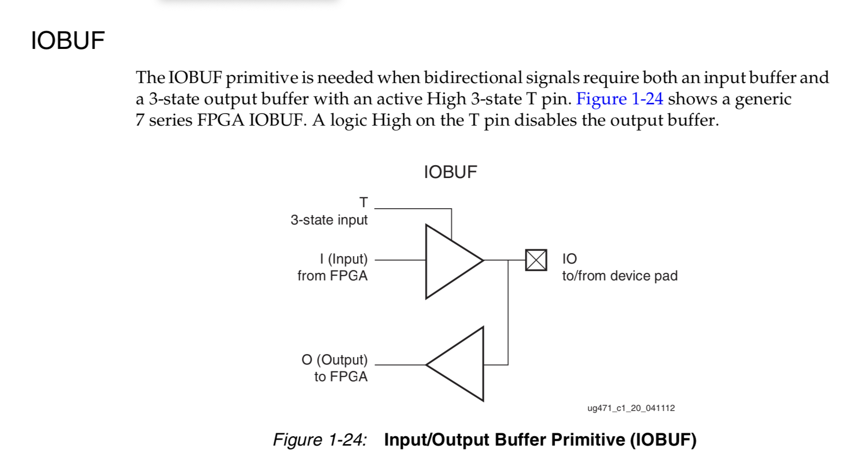
IOBUF

Slide 17
ttl_serdes_7series.InOut_8X
_SerdesDriver
rtlink = rtlink.Interface
rio_phy_clk
IInterface = i
OInterface = o
serdes_o[7:0]
rio_phy_clk
previous_data
stb
stb
8
stb
1 0
time
stamped
address[1:0]
2
data[0]
data
data[0:0]
data[1:0]
fine_ts[2:0]
fine_ts[2:0]
fine_ts[2:0]
override_en
1 0
delay = 0
busy
delay = 0
8
8
1 0
serdes = _IOSERDESE2_8X
1 0
o[7:0]
override_o
x8
x8
i[7:0]
override_en
edges[fine_ts]
0 8’b11111111
1 8’b11111110
2 8’b11111100
3 8’b11111000
4 8’b11110000
5 8’b11100000
6 8’b11000000
7 8’b10000000
oe
override_o
oserdes=
_OSERDESE2_8X
iserdes=
_ISERDESE2_8X
oe
input_state
override_oe
oe_k
sensitivity[1:0]
sample

Slide 18
ttl_serdes_7series.InOut_8X
rtlink = rtlink.Interface
IInterface = i
OInterface = o
stb
stb
time
stamped
address[1:0]
address[0]
address[1]
data[0:0]
data[1:0]
fine_ts[2:0]
fine_ts[2:0]
delay = 0
busy
delay = 0
serdes = _IOSERDESE2_8X
address == 2’b01
o[7:0]
i[7:0]
override_en
oe
oserdes=
_OSERDESE2_8X
iserdes=
_ISERDESE2_8X
rio_phy_clk
rio_phy_clk
oe_k
1 0
override_o
oe
1 0
data[0]
input_state
override_oe

Slide 19
ttl_serdes_7series.InOut_8X
rtlink = rtlink.Interface
IInterface = i
OInterface = o
stb
rio_phy_clk
stb
time
stamped
address[1:0]
data[0:0]
i[7]
data[1:0]
rio_phy_clk
fine_ts[2:0]
rio_phy_clk
fine_ts[2:0]
address[1]
delay = 0
busy
delay = 0
rio_clk
2
serdes = _IOSERDESE2_8X
sensitivity[0]
i[7]
sensitivity[1:0]
1 0
o[7:0]
2
sensitivity[1]
i[7:0]
~i[7]
rio_clk
oe
3
sample
address[0]
PriorityEncoder
oserdes=
_OSERDESE2_8X
iserdes=
_ISERDESE2_8X
8
i[7]
input_state
rio_phy_clk
override_o
oe
x8
i_d
i[7]
override_oe
oe_k
override_en

Slide 20
/* Machine-generated using Migen */ module top( ); reg [4:0] i = 5'd0; reg [2:0] o; wire n;
always @(*) begin o <= 3'd0; if (i[4]) begin o <= 3'd4; end if (i[3]) begin o <= 2'd3; end if (i[2]) begin o <= 2'd2; end if (i[1]) begin o <= 1'd1; end if (i[0]) begin o <= 1'd0; end end assign n = (i == 1'd0); endmodule
i[4] | i[3] | i[2] | i[1] | i[0] | o
1 | 0 | 0 | 0 | 0 | 5’d4
x | 1 | 0 | 0 | 0 | 5’d3
x | x | 1 | 0 | 0 | 5’d2
x | x | x | 1 | 0 | 5’d1
x | x | x | x | 1 | 5’d0
0 | 0 | 0 | 0 | 0 | 5’d0

Slide 21
gateware

Slide 22
ttl_simple.Output

Slide 23
ttl_simple.Output
rtlink = rtlink.Interface
OInterface = o
stb
data[0:0]
busy
delay = 0
override_en
override_o
1 0
pad_k
1 0
pad_o
rio_phy_clk
pad
rio_phy_clk

Slide 24
TSC

Slide 25
TSC
glbl_fine_ts_width = 3
load_value[60:0]
ADD
1 0
load
SRL
full_ts[63:0]
61‘d1
rtio_clk
coarse_ts[60:0]
SRL
GrayCodeTransfer
full_ts_sys[63:0]
i
coarse_ts_sys[60:0]
o

Slide 26
SED:Lane Distributor

Slide 27
cri (interface)
cmd[1:0]
MASTER TO SLAVE command
A<B
A<<B
A>>B
chan_sel[23:0]
MASTER TO SLAVE channel
SLT
SLL
SRL
o_timestamp[63:0]
MASTER TO SLAVE now
o_data[511:0]
MASTER TO SLAVE opcode?
o_address[7:0]
A
B
A
B
A
B
MASTER TO SLAVE
o_status[2:0]
SLAVE TO MASTER underflow, wait
A==B
A-B
A+B
o_buffer_space_valid
SLAVE TO MASTER X
ADD
EQUAL?
SUB
o_buffer_space[15:0]
SLAVE TO MASTER X
i_timeout[63:0]
MASTER TO SLAVE
i_data[31:0]
SLAVE TO MASTER
A
B
A
B
A
B
i_timestamp[63:0]
SLAVE TO MASTER
i_status[3:0]
SLAVE TO MASTER

Slide 28
output[0,1,2,…,7]
timestamp_above_min
cri (interface)
we
payload
timestamp_above_last
cmd[1:0]
writable
channel[4:0]
timestamp_above_laneA_min
seqn[11:0]
timestamp[63:0]
timestamp_above_laneB_min
chan_sel[23:0]
address[7:0]
timestamp_above_lane_min
o_timestamp[63:0]
data[31:0]
force_laneB
o_data[511:0]
o_address[7:0]
LogChannel = 28
glbl_fine_ts_width = 3
“write” = 2’d01
use_laneB
o_status[2:0]
use_lanen[2:0]
sequence_error
min_minus_timestamp[61:0]
o_buffer_space_valid
laneAmin_minus_timestamp[61:0]
do_write
sequnec_error_channel[15:0]
o_buffer_space[15:0]
minimum_corase_timestamp[60:0]
laneBmin_minus_timestamp[61:0]
do_underflow
i_timeout[63:0]
o_status_wait
last_minus_timestamp[61:0]
do_sequence_error
i_data[31:0]
o_status_underflow
current_lane_plus_one[2:0]
compensated_timestamp[63:0]
i_timestamp[63:0]
current_lane[2:0]
current_lane_writable
i_status[3:0]
last_coarse_timestamp[60:0]
quash
current_lanewritable_r
last_lane_coarse_timestamps[0,1,2…7][60:0]
latency_compensation.adr[4:0]
seqn[11:0]
latency_compensation.dat_r[4:0]
coarse_timestamp[60:0]
compensation[13:0}

Slide 29
output[0,1,2,…,7]
cri (interface)
we
payload
cmd[1:0]
writable
channel[4:0]
rsys_clk
quash
seqn[11:0]
timestamp[63:0]
chan_sel[23:0]
EQUAL?
address[7:0]
o_timestamp[63:0]
data[31:0]
o_data[511:0]
o_address[7:0]
LogChannel = 28
o_status[2:0]
o_buffer_space_valid
compensated_timestamp[63:0]
MEMORY
o_buffer_space[15:0]
ADD
i_timeout[63:0]
latency_compensation.adr[4:0]
address “rsys”
delay[0] = 14’d0
delay[1] = 14’d0
.
.
.
delay[28] = 14’d0
i_data[31:0]
latency_compensation.dat_r[4:0]
data “rsys”
i_timestamp[63:0]
SLL
i_status[3:0]
compensation[13:0]
glbl_fine_ts_width = 3

Slide 30
set time to release signal
output[0,1,2,…,7]
check whether release signal physically,
or report to log channel
cri (interface)
we
payload
cmd[1:0]
writable
channel[4:0]
rsys_clk
quash
seqn[11:0]
timestamp[63:0]
chan_sel[23:0]
EQUAL?
address[7:0]
o_timestamp[63:0]
data[31:0]
o_data[511:0]
o_address[7:0]
LogChannel = 28
o_status[2:0]
channel number of log channel
o_buffer_space_valid
compensated_timestamp[63:0]
considering delay of signal
(set for each port previously)
MEMORY
o_buffer_space[15:0]
ADD
i_timeout[63:0]
latency_compensation.adr[4:0]
address “rsys”
delay[0] = 14’d0
delay[1] = 14’d0
.
.
.
delay[28] = 14’d0
i_data[31:0]
latency_compensation.dat_r[4:0]
data “rsys”
i_timestamp[63:0]
SLL
i_status[3:0]
scale of more precise clock
saved delay data.
get address, and release delay data
synchronously (“rsys_clk”)
compensation[13:0]
glbl_fine_ts_width = 3

Slide 31
output[0,1,2,…,7]
we
current_lane_plus_one[2:0]
cri (interface)
writable
payload
channel[4:0]
ADD
cmd[1:0]
timestamp[63:0]
chan_sel[23:0]
rsys_clk
address[7:0]
o_timestamp[63:0]
current_lane[2:0]
4‘d1
data[31:0]
o_address[7:0]
o_data[511:0]
seqn[11:0]
o_status[2:0]
seqn[11:0]
o_buffer_space_valid
rsys_clk
o_buffer_space[15:0]
o_status_wait
o_status_underflow
rsys_clk
rsys_clk
rsys_clk
i_timeout[63:0]
last_minus_timestamp[61:0]
laneBmin_minus_timestamp[61:0]
laneAmin_minus_timestamp[61:0]
i_data[31:0]
SUB
min_minus_timestamp[61:0]
SUB
SUB
i_timestamp[63:0]
rsys_clk
i_status[3:0]
SUB
MUX
MUX
minimum_corase_timestamp[60:0]
coarse_timestamp[60:0]
last_coarse_timestamp[60:0]
last_lane_coarse_timestamps[0,1,2…7][60:0]
rsys_clk
rsys_clk

Slide 32
output[0,1,2,…,7]
payload
EQUAL?
cri (interface)
we
do_write
channel[4:0]
1 0
cmd[1:0]
writable
do_sequence_error
timestamp[63:0]
1 0
chan_sel[23:0]
seqn[11:0]
“write” = 2’d01
do_underflow
address[7:0]
o_timestamp[63:0]
data[31:0]
quash
o_data[511:0]
rsys_clk
o_address[7:0]
o_status[2:0]
rsys_clk
min_minus_timestamp[61:0]
SLT
o_buffer_space_valid
timestamp_above_min
timestamp_above_lane_min
o_buffer_space[15:0]
1 0
i_timeout[63:0]
rsys_clk
laneAmin_minus_timestamp[61:0]
SLT
timestamp_above_laneA_min
i_data[31:0]
i_timestamp[63:0]
rsys_clk
laneBmin_minus_timestamp[61:0]
SLT
i_status[3:0]
timestamp_above_laneB_min
use_laneB
use_lanen[2:0]
force_laneB
rsys_clk
last_minus_timestamp[61:0]
SLT
1 0
timestamp_above_last
rsys_clk
compensation[13:0}
current_lane_plus_one[2:0]
current_lane[2:0]

Slide 33
output[0,1,2,…,7]
cri (interface)
we
payload
rsys_clk
seqn[11:0]
cmd[1:0]
writable
channel[4:0]
1 0
seqn[11:0]
timestamp[63:0]
chan_sel[23:0]
address[7:0]
o_timestamp[63:0]
ADD
data[31:0]
o_data[511:0]
o_address[7:0]
12‘d1
o_status[2:0]
do_write
o_buffer_space_valid
rsys_clk
rsys_clk
rsys_clk
o_buffer_space[15:0]
last_coarse_timestamp[60:0]
last_lane_coarse_timestamps[0,1,2…7][60:0]
current_lane[2:0]
i_timeout[63:0]
1 0
i_data[31:0]
DEMUX
1 0
i_timestamp[63:0]
1 0
i_status[3:0]
compensated_timestamp[63:0]
SRL
use_lanen[2:0]
glbl_fine_ts_width = 3

Slide 34
do_write
DEMUX
1 0
last_lane_coarse_timestamps[0][60:0]
rsys_clk
1 0
last_lane_coarse_timestamps[1][60:0]
rsys_clk
1 0
last_lane_coarse_timestamps[2][60:0]
rsys_clk
1 0
last_lane_coarse_timestamps[3][60:0]
rsys_clk
1 0
last_lane_coarse_timestamps[4][60:0]
rsys_clk
1 0
last_lane_coarse_timestamps[5][60:0]
rsys_clk
1 0
last_lane_coarse_timestamps[6][60:0]
rsys_clk
1 0
last_lane_coarse_timestamps[7][60:0]
rsys_clk

Slide 35
output[0,1,2,…,7]
1’d0
1’d1
payload
EQUAL?
cri (interface)
we
1 0
cmd[1:0]
writable
channel[4:0]
seqn[11:0]
timestamp[63:0]
chan_sel[23:0]
“write” = 2’d01
address[7:0]
do_sequence_error
o_timestamp[63:0]
rsys_clk
data[31:0]
do_underflow
1 0
o_data[511:0]
sequence_error
o_address[7:0]
o_status[2:0]
rsys_clk
o_status_underflow
o_buffer_space_valid
rsys_clk
rsys_clk
current_lane[2:0]
MUX
sequnec_error_channel[15:0]
o_buffer_space[15:0]
1’d1
1’d0
rsys_clk
i_timeout[63:0]
current_lane_writable
current_lanewritable_r
1 0
i_data[31:0]
i_timestamp[63:0]
i_status[3:0]
o_status_wait
do_write
1 0
use_lanen[2:0]
MUX
rsys_clk
force_laneB

Slide 36
SED:FIFOs

Slide 37
AsyncFIFOBuffered = fifos
AsyncFIFO
produce
(GrayCounter)
consume
(GrayCounter)
_FIFOInterface
_FIFOInterface
we
we
ce
q[7:0]
ce
q[7:0]
q_next_binary[7:0]
rsys_clk
q_next_binary[7:0]
rio_clk
writable
writable
q_binary[7:0]
q_binary[7:0]
rsys_clk
consume_wdomain[7:0]
re
re
q[7]
readable
1 0
readable
consume_wdomain[7]
8
rio_clk
q[6]
consume_wdomain[6]
q[5:0]
8
6
din[120:0]
consume_wdomain[5:0]
din[120:0]
produce_rdomain[7:0]
rio_clk
q_binary[6:0]
MEMORY
adr(address) “rsys_clk”
dout[120:0]
1 0
dout[120:0]
7
we(write enable) comb
121
rio_clk
dat_w(data write)“rsys_clk”
q_binary[6:0]
121
7
adr(address) “rio_clk”
depth_bits = log2_int(depth = 128)=7
dout(data out) comb

Slide 38
GrayCounter
q_binary[7:0]
8‘d1
rsys_clk
ADD
ce
1 0
q_next_binary[7:0]
ToGrayCode
q[7:0]
q_next[7:0]

Slide 39
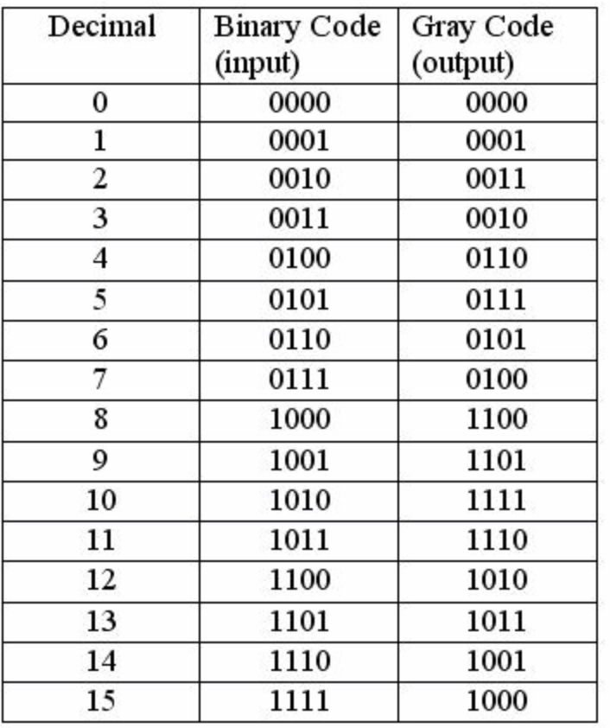

Slide 40
input[0,1,2,…,7]
fifos[0,1,2,…,7]
seqn_width = 12
we
payload
_FIFOInterface
writable
channel[4:0]
seqn[11:0]
timestamp[63:0]
address[1:0]
data[31:0]
we
writable
output[0,1,2,…,7]
re
re
payload
readable
rio_clk
readable
channel[4:0]
seqn[11:0]
timestamp[63:0]
address[1:0]
data[31:0]
din[114:0]
data[31:0]
address[7:0]
timestamp[63:0]
channel[4:0]
seqn[11:0]
12
121
dout[114:0]
109
rio_clk
data[31:0]
address[7:0]
timestamp[63:0]
channel[4:0]
seqn[11:0]

Slide 41
SED:Gates

Slide 42
61
Gates
timestamp[63:3]
61
input[0,1,2,…,7]
re
payload
readable
channel[4:0]
seqn[11:0]
timestamp[63:0]
coarse_timestamp[60:0]
address[7:0]
data[31:0]
1‘d0
output[0,1,2,…,7]
rio_clk
payload
valid
channel[4:0]
rio_clk
5
replace_occured
fine_ts[2:0]
timestamp[2:0]
rio_clk
3
nondata_replace_occured
address[7:0]
rio_clk
8
seqn[11:0]
data[31:0]
12
rio_clk
32
rio_clk

Slide 43
SED:OutputDriver

Slide 44
collision[0:0]
channel[28-0].interface.o
MEMORY
collision_channel[4:0]
onehot_stb[28-0].selected[7-0]
enable_replace[0]
enable_replace[1]
.
.
.
enable_replace[28]
address
busy
onehot_fine_ts[28-0]
busy_channel[4:0]
onehot_address[28-0]
data
replace_occured_r[7-0][0:0]
onehot_data[28-0]
nondata_replace_occured_r[7-0][0:0]
stb_r[7-0][0:0]
channel_r[7-0][4:0]
lane_datas[7-0]
output_network[7-0]
payload
valid
channel[4:0]
input
output
rio_clk
collision
rio_clk
fine_ts[2:0]
payload
payload
rio_clk
valid
channel[4:0]
valid
channel[4:0]
address[7:0]
rio_clk
replace_occured
fine_ts[2:0]
rio_clk
replace_occured
rio_clk
fine_ts[2:0]
data[31:0]
rio_clk
rio_clk
rio_clk
nondata_replace_occured
address[7:0]
nondata_replace_occured
address[7:0]
seqn[11:0]
data[31:0]
rio_clk
seqn[11:0]
rio_clk
data[31:0]
rio_clk
rio_clk

Slide 45
output_network[7-0]
input
output
payload
payload
valid
channel[4:0]
valid
channel[4:0]
replace_occured
fine_ts[2:0]
rio_clk
replace_occured
rio_clk
fine_ts[2:0]
rio_clk
rio_clk
rio_clk
nondata_replace_occured
address[7:0]
nondata_replace_occured
address[7:0]
1‘d1
rio_clk
rio_clk
1 0
collision[0:0]
seqn[11:0]
data[31:0]
seqn[11:0]
data[31:0]
1‘d0
rio_clk
rio_clk
rio_clk
4‘d0
1 0
collision_channel[4:0]
lane_datas[7-0]
replace_occured_r[7-0]
payload
nondata_replace_occured_r[7-0]
valid
channel[4:0]
MEMORY
rio_clk
collision
rio_clk
fine_ts[2:0]
enable_replace[0]
enable_replace[1]
.
.
.
enable_replace[28]
address
rio_clk
address[7:0]
rio_clk
data[31:0]
rio_clk
data

Slide 46
lane_datas[0]
lane_datas[7]
payload
payload
valid
channel[4:0]
valid
channel[4:0]
rio_clk
collision
rio_clk
fine_ts[2:0]
. . .
rio_clk
collision
rio_clk
fine_ts[2:0]
rio_clk
rio_clk
address[7:0]
address[7:0]
rio_clk
data[31:0]
rio_clk
data[31:0]
rio_clk
rio_clk
onehot_stb[28-0].selected[7-0]
onehot_stb[0].selected[0]
. . .
onehot_stb[0].selected[7]
EQUAL?
EQUAL?
. . .
. . .
5’d0
5’d0
. . .
onehot_stb[28].selected[0]
. . .
onehot_stb[28].selected[7]
EQUAL?
EQUAL?
5’d28
5’d28

Slide 47
lane_datas[0]
lane_datas[7]
payload
payload
valid
channel[4:0]
valid
channel[4:0]
rio_clk
collision
rio_clk
fine_ts[2:0]
rio_clk
collision
rio_clk
fine_ts[2:0]
rio_clk
rio_clk
channel[0].interface.o
address[7:0]
address[7:0]
stb
rio_clk
data[31:0]
rio_clk
data[31:0]
rio_clk
address[7:0]
rio_clk
rio_clk
rio_clk
rio_clk
data[1:0]
rio_clk
fine_ts[2:0]
onehot_stb[0].selected[0]
. . .
onehot_stb[0].selected[7]
busy
1 0
32’d0
1 0
32’d0
channel[28].interface.o
rio_clk
stb
. . .
. . .
rio_clk
address[7:0]
. . .
onehot_stb[28].selected[0]
onehot_stb[28].selected[7]
rio_clk
data[1:0]
rio_clk
fine_ts[2:0]
32’d0
1 0
busy
1 0
32’d0

Slide 48
lane_datas[0]
lane_datas[7]
payload
payload
valid
channel[4:0]
valid
channel[4:0]
rio_clk
collision
rio_clk
fine_ts[2:0]
rio_clk
collision
rio_clk
fine_ts[2:0]
rio_clk
rio_clk
channel[0].interface.o
address[7:0]
address[7:0]
stb
rio_clk
data[31:0]
rio_clk
data[31:0]
rio_clk
address[7:0]
rio_clk
rio_clk
rio_clk
rio_clk
data[1:0]
rio_clk
fine_ts[2:0]
onehot_stb[0].selected[0]
. . .
onehot_stb[0].selected[7]
busy
1 0
32’d0
1 0
32’d0
channel[28].interface.o
rio_clk
stb
. . .
. . .
rio_clk
address[7:0]
. . .
onehot_stb[28].selected[0]
onehot_stb[28].selected[7]
rio_clk
data[1:0]
rio_clk
fine_ts[2:0]
32’d0
1 0
busy
1 0
32’d0

Slide 49
lane_datas[0]
lane_datas[7]
payload
payload
valid
channel[4:0]
valid
channel[4:0]
rio_clk
collision
rio_clk
fine_ts[2:0]
rio_clk
collision
rio_clk
fine_ts[2:0]
rio_clk
rio_clk
channel[0].interface.o
address[7:0]
address[7:0]
stb
rio_clk
data[31:0]
rio_clk
data[31:0]
rio_clk
address[7:0]
rio_clk
rio_clk
rio_clk
rio_clk
data[1:0]
rio_clk
fine_ts[2:0]
onehot_stb[0].selected[0]
. . .
onehot_stb[0].selected[7]
busy
1 0
32’d0
1 0
32’d0
channel[28].interface.o
rio_clk
stb
. . .
. . .
rio_clk
address[7:0]
. . .
onehot_stb[28].selected[0]
onehot_stb[28].selected[7]
rio_clk
data[1:0]
rio_clk
fine_ts[2:0]
32’d0
1 0
busy
1 0
32’d0

Slide 50
lane_datas[7-0]
payload
valid
channel[4:0]
rio_clk
collision
rio_clk
fine_ts[2:0]
rio_clk
address[7:0]
rio_clk
data[31:0]
rio_clk
rio_clk
stb_r[7-0]
channel_r[7-0][4:0]
rio_clk
channel[28-0].interface.o
rio_clk
stb
rio_clk
address[7:0]
MUX
rio_clk
data[1:0]
rio_clk
fine_ts[2:0]
1’d1
busy
1 0
busy
rio_clk
1’d0
1 0
busy_channel[4:0]
rio_clk
5’d0

Slide 51
OutpuDriver:OutputNetwork

Slide 53
k1
node1 < node2
~valid
channel[4:0]
input[node1]
output[node1]
payload
payload
valid
channel[4:0]
valid
channel[4:0]
rio_clk
replace_occured
rio_clk
fine_ts[2:0]
rio_clk
replace_occured
rio_clk
fine_ts[2:0]
rio_clk
rio_clk
compare &
distribute
rio_clk
rio_clk
nondata_replace_occured
address[7:0]
k1
seqn1
nondata_replace_occured
address[7:0]
rio_clk
seqn[11:0]
rio_clk
data[31:0]
rio_clk
seqn[11:0]
rio_clk
data[31:0]
rio_clk
rio_clk
node1
node1
rio_clk
rio_clk
input[node2]
node2
node2
output[node2]
payload
payload
valid
channel[4:0]
k2
seqn2
valid
channel[4:0]
rio_clk
rio_clk
rio_clk
rio_clk
replace_occured
fine_ts[2:0]
replace_occured
fine_ts[2:0]
rio_clk
rio_clk
rio_clk
rio_clk
nondata_replace_occured
address[7:0]
nondata_replace_occured
address[7:0]
rio_clk
rio_clk
rio_clk
rio_clk
seqn[11:0]
data[31:0]
seqn[11:0]
data[31:0]
rio_clk
rio_clk
rio_clk
rio_clk
k2
~valid
channel[4:0]

Slide 54
~valid
channel[4:0]
k1
SLT
~valid
channel[4:0]
k2
input
SLT
node1
rio_clk
cmp_wrap
seqn[11:0]
i1
o
seqn[11:0]
i2
rio_clk
1‘d1
1 0
replace_occured
rio_clk
rio_clk
input[node2]
1 0
input.replace_occured
nondata_replace_occured
input[node1]
1 0
1 0
input.nondata_replace_occured
node2
node1
input[node1]
1 0
1‘d0
1 0
1 0
valid
channel[4:0]
input[node2]
input.valid
rio_clk
rio_clk
fine_ts[2:0]
rio_clk
address[7:0]
rio_clk
node2
channel[4:0]
rio_clk
nondata_difference
fine_ts[2:0]
rio_clk
input
address[7:0]
rio_clk

Slide 55
cmp_wrap
i1
seqn[11:0]
SLT
i1[11]
12
i1[10]
o
i1[11]
1 0
i1[11]
i2[11]
i2
seqn[11:0]
12
i2[11]
i2[10]

Slide 56
SED:InputCollector

Slide 57
ttl_serdes_7series.InOut
output_port
input_timeout[63:0]
rsys_clk
fifo=AsyncFIFO
IInterface = i
cri (interface)
input_pending[0:0]
rsys_clk
_FIFOInterface
stb
rio_phy_clk
cmd[1:0]
2
i_status_raw[1:0]
rsys_clk
we
time
stamped
chan_sel[23:16]
data[0:0]
writable
i_statuses
chan_sel[23:0]
sel[7:0]
rio_phy_clk
counter_rtio[60:0]
fine_ts[2:0]
61
8
fine_ts[2:0]
rio_phy_clk
fifo_in
o_timestamp[63:0]
i_ack
re
3
readable
data
o_data[511:0]
rsys_clk
timestamp[63:0]
din[64:0]
i_statuses
64
o_address[7:0]
65
time_stamp[63:0]
data[0:0]
65
dout[64:0]
i_statuses
fifo_out
o_status[2:0]
65
time_stamp[63:0]
data[0:0]
data
o_buffer_space_valid
timestamp[63:0]
i_datas
o_buffer_space[15:0]
i_statuses[1:0]
MUX
64
BlindTransfer
i_timeout[63:0]
8
i_statuses
[1]
[0]
overflow
i
o
i_data[31:0]
2
rsys_clk
rsys_clk
i_timestamp[63:0]
SLL
64
i_timestamp[63:0]
rsys_clk
64
0
i_status[3:0]
selected
rsys_clk
overflow_io
overflow_trigger
counter_rtio[60:0]
EQUAL?
8
TSC
61
n
rtio_clk
full_ts_cri[63:0]
coarse_ts[60:0]

Slide 58
output_port
input_timeout[63:0]
rsys_clk
fifo=AsyncFIFO
IInterface = i
cri (interface)
input_pending[0:0]
rsys_clk
_FIFOInterface
stb
rio_phy_clk
cmd[1:0]
2
i_status_raw[1:0]
rsys_clk
we
time
stamped
chan_sel[23:16]
data[0:0]
writable
i_statuses
chan_sel[23:0]
sel[7:0]
rio_phy_clk
counter_rtio[60:0]
fine_ts[2:0]
61
8
fine_ts[2:0]
rio_phy_clk
fifo_in
o_timestamp[63:0]
i_ack
re
3
readable
data
o_data[511:0]
rsys_clk
timestamp[63:0]
din[64:0]
i_statuses
64
o_address[7:0]
65
time_stamp[63:0]
data[0:0]
65
dout[64:0]
i_statuses
fifo_out
o_status[2:0]
65
time_stamp[63:0]
data[0:0]
data
o_buffer_space_valid
timestamp[63:0]
i_datas
o_buffer_space[15:0]
i_statuses[1:0]
MUX
64
BlindTransfer
i_timeout[63:0]
8
i_statuses
[1]
[0]
overflow
i
o
i_data[31:0]
2
rsys_clk
rsys_clk
i_timestamp[63:0]
SLL
64
i_timestamp[63:0]
rsys_clk
64
0
i_status[3:0]
selected
rsys_clk
overflow_io
overflow_trigger
counter_rtio[60:0]
EQUAL?
8
TSC
61
n
rtio_clk
full_ts_cri[63:0]
coarse_ts[60:0]

Slide 59
output_port
input_timeout[63:0]
rsys_clk
fifo=AsyncFIFO
IInterface = i
cri (interface)
input_pending[0:0]
rsys_clk
_FIFOInterface
stb
rio_phy_clk
cmd[1:0]
2
i_status_raw[1:0]
rsys_clk
we
time
stamped
chan_sel[23:16]
data[0:0]
writable
i_statuses
chan_sel[23:0]
sel[7:0]
rio_phy_clk
counter_rtio[60:0]
fine_ts[2:0]
61
8
fine_ts[2:0]
rio_phy_clk
fifo_in
o_timestamp[63:0]
i_ack
re
3
readable
data
o_data[511:0]
rsys_clk
timestamp[63:0]
din[64:0]
i_statuses
64
o_address[7:0]
65
time_stamp[63:0]
data[0:0]
65
dout[64:0]
i_statuses
fifo_out
o_status[2:0]
65
time_stamp[63:0]
data[0:0]
data
o_buffer_space_valid
timestamp[63:0]
i_datas
o_buffer_space[15:0]
i_statuses[1:0]
MUX
64
BlindTransfer
i_timeout[63:0]
8
i_statuses
[1]
[0]
overflow
i
o
i_data[31:0]
2
rsys_clk
rsys_clk
i_timestamp[63:0]
SLL
64
i_timestamp[63:0]
rsys_clk
64
0
i_status[3:0]
selected
rsys_clk
overflow_io
overflow_trigger
counter_rtio[60:0]
EQUAL?
8
TSC
61
n
rtio_clk
full_ts_cri[63:0]
coarse_ts[60:0]

Slide 60
output_port
input_timeout[63:0]
rsys_clk
fifo=AsyncFIFO
IInterface = i
cri (interface)
input_pending[0:0]
rsys_clk
_FIFOInterface
stb
rio_phy_clk
cmd[1:0]
2
i_status_raw[1:0]
rsys_clk
we
time
stamped
chan_sel[23:16]
data[0:0]
writable
i_statuses
chan_sel[23:0]
sel[7:0]
rio_phy_clk
counter_rtio[60:0]
fine_ts[2:0]
61
8
fine_ts[2:0]
rio_phy_clk
fifo_in
o_timestamp[63:0]
i_ack
re
3
readable
data
o_data[511:0]
rsys_clk
timestamp[63:0]
din[64:0]
i_statuses
64
o_address[7:0]
65
time_stamp[63:0]
data[0:0]
65
dout[64:0]
i_statuses
fifo_out
o_status[2:0]
65
time_stamp[63:0]
data[0:0]
data
o_buffer_space_valid
timestamp[63:0]
i_datas
o_buffer_space[15:0]
i_statuses[1:0]
MUX
64
BlindTransfer
i_timeout[63:0]
8
i_statuses
[1]
[0]
overflow
i
o
i_data[31:0]
2
rsys_clk
rsys_clk
i_timestamp[63:0]
SLL
64
i_timestamp[63:0]
rsys_clk
64
0
i_status[3:0]
selected
rsys_clk
overflow_io
overflow_trigger
counter_rtio[60:0]
EQUAL?
8
TSC
61
n
rtio_clk
full_ts_cri[63:0]
coarse_ts[60:0]

Slide 61
output_port
input_timeout[63:0]
rsys_clk
fifo=AsyncFIFO
IInterface = i
cri (interface)
input_pending[0:0]
rsys_clk
_FIFOInterface
stb
rio_phy_clk
cmd[1:0]
2
i_status_raw[1:0]
rsys_clk
we
time
stamped
chan_sel[23:16]
data[0:0]
writable
i_statuses
chan_sel[23:0]
sel[7:0]
rio_phy_clk
counter_rtio[60:0]
fine_ts[2:0]
61
8
fine_ts[2:0]
rio_phy_clk
fifo_in
o_timestamp[63:0]
i_ack
re
3
readable
data
o_data[511:0]
rsys_clk
timestamp[63:0]
din[64:0]
i_statuses
64
o_address[7:0]
65
time_stamp[63:0]
data[0:0]
65
dout[64:0]
i_statuses
fifo_out
o_status[2:0]
65
time_stamp[63:0]
data[0:0]
data
o_buffer_space_valid
timestamp[63:0]
i_datas
o_buffer_space[15:0]
i_statuses[1:0]
MUX
64
BlindTransfer
i_timeout[63:0]
8
i_statuses
[1]
[0]
overflow
i
o
i_data[31:0]
2
rsys_clk
rsys_clk
i_timestamp[63:0]
SLL
64
i_timestamp[63:0]
rsys_clk
64
0
i_status[3:0]
selected
rsys_clk
overflow_io
overflow_trigger
counter_rtio[60:0]
EQUAL?
8
TSC
61
n
rtio_clk
full_ts_cri[63:0]
coarse_ts[60:0]

Slide 62
spi2.SPIMaster
output_port
input_timeout[63:0]
rsys_clk
fifo=AsyncFIFO
IInterface = i
cri (interface)
input_pending[0:0]
rsys_clk
_FIFOInterface
stb
rio_phy_clk
cmd[1:0]
2
i_status_raw[1:0]
rsys_clk
we
time
stamped
chan_sel[23:16]
data[31:0]
chan_sel[23:0]
sel[7:0]
writable
rio_phy_clk
32
8
fine_ts[0:0]
rio_phy_clk
fifo_in
o_timestamp[63:0]
i_ack
re
readable
data[31:0]
o_data[511:0]
rsys_clk
din[32:0]
i_statuses
62
o_address[7:0]
32
data[31:0]
32
dout[32:0]
i_statuses
fifo_out
o_status[2:0]
32
data[31:0]
32
data[31:0]
o_buffer_space_valid
i_datas[31:0]
o_buffer_space[15:0]
32
i_statuses[1:0]
i_timeout[63:0]
MUX
BlindTransfer
8
i_statuses
[1]
[0]
overflow
i
o
i_data[31:0]
2
rsys_clk
rsys_clk
i_timestamp[63:0]
i_timestamp[63:0]
64
0
rsys_clk
i_status[3:0]
selected
rsys_clk
overflow_io
overflow_trigger
counter_rtio[60:0]
EQUAL?
8
TSC
61
n
rtio_clk
full_ts_cri[63:0]
coarse_ts[60:0]

Slide 63
ttl_serdes_7series.InOut
TSC
output_port
rsys_clk
rtio_clk
fifo_in
input_timeout[63:0]
coarse_ts[60:0]
fifo=AsyncFIFO
data
cri (interface)
input_pending[0:0]
rsys_clk
full_ts_cri[63:0]
_FIFOInterface
timestamp[63:0]
cmd[1:0]
i_status_raw[1:0]
rsys_clk
we
fifo_out
chan_sel[23:0]
sel[7:0]
data
i_status_raw[1]
i_status_raw[0]
writable
o_timestamp[63:0]
re
timestamp[63:0]
o_data[511:0]
o_address[7:0]
EQUAL?
readable
BlindTransfer
2
i
o
o_status[2:0]
din[64:0]
2
dout[64:0]
IInterface = i
o_buffer_space_valid
2’d2=“read”
stb
o_buffer_space[15:0]
rio_phy_clk
time
stamped
i_timeout[63:0]
data[0:0]
8
rio_phy_clk
rsys_clk
fine_ts[2:0]
i_data[31:0]
1 0
rio_phy_clk
MUX
i_datas
overflow
rsys_clk
8
i_statuses[1:0]
rsys_clk
64
1 0
overflow_trigger
i_timestamp[63:0]
MUX
1 0
64
i_timestamp[63:0]
64
64
1
overflow_io
3
1 0
selected
1 0
i_status[3:0]
1 0
3
i_statuses
counter_rtio[60:0]
3
3
0
i_status_raw[1]
~i_status_raw[0]
rsys_clk
3’b100
0
3
i_ack
rsys_clk

Slide 64
TSC
output_port
rsys_clk
rtio_clk
fifo_in
input_timeout[63:0]
coarse_ts[60:0]
fifo=AsyncFIFO
data
cri (interface)
input_pending[0:0]
rsys_clk
full_ts_cri[63:0]
_FIFOInterface
timestamp[63:0]
cmd[1:0]
i_status_raw[1:0]
rsys_clk
we
fifo_out
chan_sel[23:0]
sel[7:0]
data
i_status_raw[1]
i_status_raw[0]
writable
o_timestamp[63:0]
re
timestamp[63:0]
o_data[511:0]
o_address[7:0]
EQUAL?
readable
BlindTransfer
2
i
o
o_status[2:0]
din[64:0]
2
dout[64:0]
IInterface = i
o_buffer_space_valid
2’d2=“read”
stb
o_buffer_space[15:0]
rio_phy_clk
time
stamped
i_timeout[63:0]
data[0:0]
8
rio_phy_clk
rsys_clk
fine_ts[2:0]
i_data[31:0]
1 0
rio_phy_clk
MUX
i_datas
overflow
rsys_clk
8
i_statuses[1:0]
rsys_clk
64
1 0
overflow_trigger
i_timestamp[63:0]
MUX
1 0
64
i_timestamp[63:0]
64
64
1
overflow_io
3
1 0
selected
1 0
i_status[3:0]
1 0
3
i_statuses
counter_rtio[60:0]
3
3
0
i_status_raw[1]
~i_status_raw[0]
rsys_clk
3’b100
0
3
i_ack
rsys_clk

Slide 65
TSC
output_port
rsys_clk
rtio_clk
fifo_in
input_timeout[63:0]
coarse_ts[60:0]
fifo=AsyncFIFO
data
cri (interface)
input_pending[0:0]
rsys_clk
full_ts_cri[63:0]
_FIFOInterface
timestamp[63:0]
cmd[1:0]
i_status_raw[1:0]
rsys_clk
we
fifo_out
chan_sel[23:0]
sel[7:0]
data
i_status_raw[1]
i_status_raw[0]
writable
o_timestamp[63:0]
re
timestamp[63:0]
o_data[511:0]
o_address[7:0]
EQUAL?
readable
BlindTransfer
2
i
o
o_status[2:0]
din[64:0]
2
dout[64:0]
IInterface = i
o_buffer_space_valid
2’d2=“read”
stb
o_buffer_space[15:0]
rio_phy_clk
time
stamped
i_timeout[63:0]
data[0:0]
8
rio_phy_clk
rsys_clk
fine_ts[2:0]
i_data[31:0]
1 0
rio_phy_clk
MUX
i_datas
overflow
rsys_clk
8
i_statuses[1:0]
rsys_clk
64
1 0
overflow_trigger
i_timestamp[63:0]
MUX
1 0
64
i_timestamp[63:0]
64
64
1
overflow_io
3
1 0
selected
1 0
i_status[3:0]
1 0
3
i_statuses
counter_rtio[60:0]
3
3
0
i_status_raw[1]
~i_status_raw[0]
rsys_clk
3’b100
0
3
i_ack
rsys_clk

Slide 66
TSC
output_port
rsys_clk
rtio_clk
fifo_in
input_timeout[63:0]
coarse_ts[60:0]
fifo=AsyncFIFO
data
cri (interface)
input_pending[0:0]
rsys_clk
full_ts_cri[63:0]
_FIFOInterface
timestamp[63:0]
cmd[1:0]
i_status_raw[1:0]
rsys_clk
we
fifo_out
chan_sel[23:0]
sel[7:0]
data
i_status_raw[1]
i_status_raw[0]
writable
o_timestamp[63:0]
re
timestamp[63:0]
o_data[511:0]
o_address[7:0]
EQUAL?
readable
BlindTransfer
2
i
o
o_status[2:0]
din[64:0]
2
dout[64:0]
IInterface = i
o_buffer_space_valid
2’d2=“read”
stb
o_buffer_space[15:0]
rio_phy_clk
time
stamped
i_timeout[63:0]
data[0:0]
8
rio_phy_clk
rsys_clk
fine_ts[2:0]
i_data[31:0]
1 0
rio_phy_clk
MUX
i_datas
overflow
rsys_clk
8
i_statuses[1:0]
rsys_clk
64
1 0
overflow_trigger
i_timestamp[63:0]
MUX
1 0
64
i_timestamp[63:0]
64
64
1
overflow_io
3
1 0
selected
1 0
i_status[3:0]
1 0
3
i_statuses
counter_rtio[60:0]
3
3
0
i_status_raw[1]
~i_status_raw[0]
rsys_clk
3’b100
0
3
i_ack
rsys_clk

Slide 67
TSC
output_port
rsys_clk
rtio_clk
fifo_in
input_timeout[63:0]
coarse_ts[60:0]
fifo=AsyncFIFO
data
cri (interface)
input_pending[0:0]
rsys_clk
full_ts_cri[63:0]
_FIFOInterface
timestamp[63:0]
cmd[1:0]
i_status_raw[1:0]
rsys_clk
we
fifo_out
chan_sel[23:0]
sel[7:0]
data
i_status_raw[1]
i_status_raw[0]
writable
o_timestamp[63:0]
re
timestamp[63:0]
o_data[511:0]
o_address[7:0]
EQUAL?
readable
BlindTransfer
2
i
o
o_status[2:0]
din[64:0]
2
dout[64:0]
IInterface = i
o_buffer_space_valid
2’d2=“read”
stb
o_buffer_space[15:0]
rio_phy_clk
time
stamped
i_timeout[63:0]
data[0:0]
8
rio_phy_clk
rsys_clk
fine_ts[2:0]
i_data[31:0]
1 0
rio_phy_clk
MUX
i_datas
overflow
rsys_clk
8
i_statuses[1:0]
rsys_clk
64
1 0
overflow_trigger
i_timestamp[63:0]
MUX
1 0
64
i_timestamp[63:0]
64
64
1
overflow_io
3
1 0
selected
1 0
i_status[3:0]
1 0
3
i_statuses
counter_rtio[60:0]
3
3
0
i_status_raw[1]
~i_status_raw[0]
rsys_clk
3’b100
0
3
i_ack
rsys_clk

Slide 68
spi2.SPIMaster
TSC
output_port
rsys_clk
rtio_clk
fifo_in
input_timeout[63:0]
coarse_ts[60:0]
fifo=AsyncFIFO
data
cri (interface)
input_pending[0:0]
rsys_clk
full_ts_cri[63:0]
_FIFOInterface
timestamp[63:0]
cmd[1:0]
i_status_raw[1:0]
rsys_clk
we
fifo_out
chan_sel[23:0]
sel[7:0]
data
i_status_raw[1]
i_status_raw[0]
writable
o_timestamp[63:0]
re
timestamp[63:0]
o_data[511:0]
o_address[7:0]
EQUAL?
readable
BlindTransfer
2
i
o
o_status[2:0]
din[64:0]
2
dout[64:0]
IInterface = i
o_buffer_space_valid
2’d2=“read”
stb
o_buffer_space[15:0]
rio_phy_clk
time
stamped
i_timeout[63:0]
data[0:0]
32
8
rio_phy_clk
rsys_clk
fine_ts[2:0]
i_data[31:0]
1 0
rio_phy_clk
32
MUX
i_datas[31:0]
overflow
rsys_clk
32
8
32
rsys_clk
64
i_statuses[1:0]
overflow_trigger
i_timestamp[63:0]
1 0
MUX
1 0
64
i_timestamp[63:0]
64
64
1
overflow_io
3
1 0
selected
1 0
i_status[3:0]
1 0
3
i_statuses
counter_rtio[60:0]
3
3
0
i_status_raw[1]
~i_status_raw[0]
rsys_clk
3’b100
0
3
i_ack
rsys_clk

Slide 69
ttl_serdes_7series.InOut
rsys_clk
TSC
output_port
64
1 0
input_timeout[63:0]
rtio_clk
fifo_in
64
coarse_ts[60:0]
fifo=AsyncFIFO
data
cri (interface)
input_pending[0:0]
rsys_clk
full_ts_cri[63:0]
_FIFOInterface
timestamp[63:0]
cmd[1:0]
64
i_status_raw[1:0]
rsys_clk
64
we
fifo_out
chan_sel[23:0]
SLT
data
writable
o_timestamp[63:0]
sel[7:0]
2
full_ts_cri < input_timeout?
re
timestamp[63:0]
o_data[511:0]
o_address[7:0]
2
i_status_raw != 0?
readable
BlindTransfer
EQUAL?
din[64:0]
i
o
o_status[2:0]
2
IInterface = i
o_buffer_space_valid
dout[64:0]
2=“read”
stb
rio_phy_clk
o_buffer_space[15:0]
time
stamped
i_timeout[63:0]
data[0:0]
rio_phy_clk
rsys_clk
fine_ts[2:0]
i_data[31:0]
rio_phy_clk
1 0
i_datas
rsys_clk
1 0
0
i_timestamp[63:0]
1
i_statuses[1:0]
overflow_trigger
i_timestamp[63:0]
overflow_io
i_status[3:0]
rsys_clk
selected
overflow
counter_rtio[60:0]
0
rsys_clk
i_ack
rsys_clk
1 0
1

Slide 70
rsys_clk
TSC
output_port
64
1 0
input_timeout[63:0]
rtio_clk
fifo_in
64
coarse_ts[60:0]
fifo=AsyncFIFO
data
cri (interface)
input_pending[0:0]
rsys_clk
full_ts_cri[63:0]
_FIFOInterface
timestamp[63:0]
cmd[1:0]
64
i_status_raw[1:0]
rsys_clk
64
we
fifo_out
chan_sel[23:0]
SLT
data
writable
o_timestamp[63:0]
sel[7:0]
2
full_ts_cri < input_timeout?
re
timestamp[63:0]
o_data[511:0]
o_address[7:0]
2
i_status_raw != 0?
readable
BlindTransfer
EQUAL?
din[64:0]
i
o
o_status[2:0]
2
IInterface = i
o_buffer_space_valid
dout[64:0]
2=“read”
stb
rio_phy_clk
o_buffer_space[15:0]
time
stamped
i_timeout[63:0]
data[0:0]
rio_phy_clk
rsys_clk
fine_ts[2:0]
i_data[31:0]
rio_phy_clk
1 0
i_datas
rsys_clk
1 0
0
i_timestamp[63:0]
1
i_statuses[1:0]
overflow_trigger
i_timestamp[63:0]
overflow_io
i_status[3:0]
rsys_clk
selected
overflow
counter_rtio[60:0]
0
rsys_clk
i_ack
rsys_clk
1 0
1

Slide 71
rsys_clk
TSC
output_port
64
1 0
input_timeout[63:0]
rtio_clk
fifo_in
64
coarse_ts[60:0]
fifo=AsyncFIFO
data
cri (interface)
input_pending[0:0]
rsys_clk
full_ts_cri[63:0]
_FIFOInterface
timestamp[63:0]
cmd[1:0]
64
i_status_raw[1:0]
rsys_clk
64
we
fifo_out
chan_sel[23:0]
SLT
data
writable
o_timestamp[63:0]
sel[7:0]
2
full_ts_cri < input_timeout?
re
timestamp[63:0]
o_data[511:0]
o_address[7:0]
2
i_status_raw != 0?
readable
BlindTransfer
EQUAL?
din[64:0]
i
o
o_status[2:0]
2
IInterface = i
o_buffer_space_valid
dout[64:0]
2=“read”
stb
rio_phy_clk
o_buffer_space[15:0]
time
stamped
i_timeout[63:0]
data[0:0]
rio_phy_clk
rsys_clk
fine_ts[2:0]
i_data[31:0]
rio_phy_clk
1 0
i_datas
rsys_clk
1 0
0
i_timestamp[63:0]
1
i_statuses[1:0]
overflow_trigger
i_timestamp[63:0]
overflow_io
i_status[3:0]
rsys_clk
selected
overflow
counter_rtio[60:0]
0
rsys_clk
i_ack
rsys_clk
1 0
1

Slide 72
rsys_clk
TSC
output_port
64
1 0
input_timeout[63:0]
rtio_clk
fifo_in
64
coarse_ts[60:0]
fifo=AsyncFIFO
data
cri (interface)
input_pending[0:0]
rsys_clk
full_ts_cri[63:0]
_FIFOInterface
timestamp[63:0]
cmd[1:0]
64
i_status_raw[1:0]
rsys_clk
64
we
fifo_out
chan_sel[23:0]
SLT
data
writable
o_timestamp[63:0]
sel[7:0]
2
full_ts_cri < input_timeout?
re
timestamp[63:0]
o_data[511:0]
o_address[7:0]
2
i_status_raw != 0?
readable
BlindTransfer
EQUAL?
din[64:0]
i
o
o_status[2:0]
2
IInterface = i
o_buffer_space_valid
dout[64:0]
2=“read”
stb
rio_phy_clk
o_buffer_space[15:0]
time
stamped
i_timeout[63:0]
data[0:0]
rio_phy_clk
rsys_clk
fine_ts[2:0]
i_data[31:0]
rio_phy_clk
1 0
i_datas
rsys_clk
1 0
0
i_timestamp[63:0]
1
i_statuses[1:0]
overflow_trigger
i_timestamp[63:0]
overflow_io
i_status[3:0]
rsys_clk
selected
overflow
counter_rtio[60:0]
0
rsys_clk
i_ack
rsys_clk
1 0
1

Slide 73
spi2.SPIMaster
rsys_clk
TSC
output_port
64
1 0
input_timeout[63:0]
rtio_clk
fifo_in
64
coarse_ts[60:0]
fifo=AsyncFIFO
data
cri (interface)
input_pending[0:0]
rsys_clk
full_ts_cri[63:0]
_FIFOInterface
timestamp[63:0]
cmd[1:0]
64
i_status_raw[1:0]
rsys_clk
64
we
fifo_out
chan_sel[23:0]
SLT
data
writable
o_timestamp[63:0]
sel[7:0]
2
full_ts_cri < input_timeout?
re
timestamp[63:0]
o_data[511:0]
o_address[7:0]
2
i_status_raw != 0?
readable
BlindTransfer
EQUAL?
din[64:0]
i
o
o_status[2:0]
2
IInterface = i
o_buffer_space_valid
dout[64:0]
2=“read”
stb
rio_phy_clk
o_buffer_space[15:0]
time
stamped
i_timeout[63:0]
data[0:0]
rio_phy_clk
rsys_clk
fine_ts[2:0]
i_data[31:0]
rio_phy_clk
1 0
i_datas[31:0]
rsys_clk
1 0
0
i_timestamp[63:0]
1
i_statuses[1:0]
overflow_trigger
i_timestamp[63:0]
overflow_io
i_status[3:0]
rsys_clk
selected
overflow
counter_rtio[60:0]
0
rsys_clk
i_ack
rsys_clk
1 0
1

Slide 74
BlindTransfer
o
multiregimpl0_regs0
rio_clk
multiregimpl0_regs1
rio_clk
1 0
ps_toggle_i
rsys_clk
1 0
ps_toggle_o_r
rio_clk
multiregimpl1_regs1
rsys_clk
ps_ack_toggle_i
rio_clk
ps_ack_toggle_o_r
rsys_clk
i
1
i
1 0
0
multiregimpl1_regs0
rsys_clk
1 0
blind
rsys_clk

Slide 75
Process of Blind Transfer
o
0
0
multiregimpl0_regs0
rio_clk
0
multiregimpl0_regs1
0
rio_clk
1 0
ps_toggle_i
rsys_clk
0
1 0
ps_toggle_o_r
rio_clk
0
0
multiregimpl1_regs1
rsys_clk
ps_ack_toggle_i
rio_clk
ps_ack_toggle_o_r
rsys_clk
0
i
1
1
i
0
1 0
0
multiregimpl1_regs0
rsys_clk
1 0
0
blind
rsys_clk

Slide 76
Process of Blind Transfer
o
0
0
multiregimpl0_regs0
rio_clk
0
multiregimpl0_regs1
1
0
rio_clk
1 0
ps_toggle_i
rsys_clk
0
1 0
ps_toggle_o_r
rio_clk
0
0
multiregimpl1_regs1
rsys_clk
ps_ack_toggle_i
rio_clk
ps_ack_toggle_o_r
rsys_clk
0
i
1
1
i
0
1 0
0
multiregimpl1_regs0
rsys_clk
1 0
0
blind
rsys_clk

Slide 77
Process of Blind Transfer
o
0
0
multiregimpl0_regs0
rio_clk
0
multiregimpl0_regs1
1
rio_clk
1 0
ps_toggle_i
rsys_clk
0
1 0
ps_toggle_o_r
rio_clk
0
0
multiregimpl1_regs1
rsys_clk
ps_ack_toggle_i
rio_clk
ps_ack_toggle_o_r
rsys_clk
0
i
X
1
i
0
1 0
0
multiregimpl1_regs0
rsys_clk
1 0
1
blind
rsys_clk

Slide 78
Process of Blind Transfer
o
0
1
multiregimpl0_regs0
rio_clk
0
multiregimpl0_regs1
1
rio_clk
1 0
ps_toggle_i
rsys_clk
0
1 0
ps_toggle_o_r
rio_clk
0
0
multiregimpl1_regs1
rsys_clk
ps_ack_toggle_i
rio_clk
ps_ack_toggle_o_r
rsys_clk
0
i
X
1
i
0
1 0
0
multiregimpl1_regs0
rsys_clk
1 0
1
blind
rsys_clk

Slide 79
Process of Blind Transfer
o
1
1
multiregimpl0_regs0
rio_clk
1
multiregimpl0_regs1
1
rio_clk
1 0
ps_toggle_i
rsys_clk
0
1 0
ps_toggle_o_r
rio_clk
0
0
multiregimpl1_regs1
rsys_clk
ps_ack_toggle_i
rio_clk
ps_ack_toggle_o_r
rsys_clk
0
i
X
1
i
0
1 0
0
multiregimpl1_regs0
rsys_clk
1 0
1
blind
rsys_clk

Slide 80
Process of Blind Transfer
o
0
1
multiregimpl0_regs0
rio_clk
1
multiregimpl0_regs1
1
rio_clk
1 0
ps_toggle_i
rsys_clk
1
1 0
ps_toggle_o_r
rio_clk
0
1
multiregimpl1_regs1
rsys_clk
ps_ack_toggle_i
rio_clk
ps_ack_toggle_o_r
rsys_clk
0
i
X
1
i
0
1 0
0
multiregimpl1_regs0
rsys_clk
1 0
1
blind
rsys_clk

Slide 81
Process of Blind Transfer
o
0
1
multiregimpl0_regs0
rio_clk
1
multiregimpl0_regs1
1
rio_clk
1 0
ps_toggle_i
rsys_clk
1
1 0
ps_toggle_o_r
rio_clk
0
1
multiregimpl1_regs1
rsys_clk
ps_ack_toggle_i
rio_clk
ps_ack_toggle_o_r
rsys_clk
1
i
X
1
i
1
1 0
0
multiregimpl1_regs0
rsys_clk
1 0
1
blind
rsys_clk

Slide 82
Process of Blind Transfer
o
0
1
multiregimpl0_regs0
rio_clk
1
multiregimpl0_regs1
1
rio_clk
1 0
ps_toggle_i
rsys_clk
1
1 0
ps_toggle_o_r
rio_clk
1
1
multiregimpl1_regs1
rsys_clk
ps_ack_toggle_i
rio_clk
ps_ack_toggle_o_r
rsys_clk
1
i
0
1
i
1
1 0
0
multiregimpl1_regs0
rsys_clk
1 0
0
blind
rsys_clk

Slide 83
rtio.Core

Slide 84
rtio_clk
TSC
coarse_ts[60:0]
Q
FDPE
PRE
CE
coarse_ts_sys[60:0]
SED
InputCollector
D
C
0
0
0
rsys_clk
LaneDistributor
Q
FDPE
ADD
minimum_corase_timestamp[60:0]
PRE
CE
1 0
D
C
16
sequnec_error_channel[15:0]
rsys_clk
0
1 0
sequence_error
rsys_clk
Q
FDPE
PRE
CE
1 0
FIFOs
C
D
Q
1
1
1
FDPE
Gates
PRE
CE
D
C
1 0
corase_timestamp[60:0]
BlindTransfer
0
1
rsys_clk
o
i
OutputDriver
CSR
(reset_phy)
rsys_clk
1 0
data_o[15:0]
collision[0:0]
rio_clk
w
r
re
cmd_reset_phy
o_collision
data_i[15:0]
rsys_clk
1 0
collision_channel[4:0]
rio_clk
CSR
(reset)
o_busy
BlindTransfer
rsys_clk
rsys_clk
o
i
busy
rio_clk
w
r
re
cmd_reset
o_sequence_error
data_o[15:0]
busy_channel[4:0]
rio_clk
data_i[15:0]
ClockSignal
(cd_rsys)
ClockSignal
(cd_rio)
ClockSignal
(cd_rio_phy)
CSR
(async_error)
rst
clk
rst
clk
rst
clk
i_statuses
o_collision
o_busy
o_sequence_error
w[2:0]
r[2:0]
re
sys_clk
rtio_clk

Slide 85
rtio_clk
TSC
CSRStatus
(sequence_error_channel)
coarse_ts[60:0]
status[15:0]
rsys_clk
1 0
coarse_ts_sys[60:0]
SED
InputCollector
rsys_clk
LaneDistributor
CSRStatus
(busy_channel)
minimum_corase_timestamp[60:0]
status[15:0]
rsys_clk
1 0
sequnec_error_channel[15:0]
rsys_clk
sequence_error
rsys_clk
CSRStatus
(collision_channel)
FIFOs
status[15:0]
rsys_clk
1 0
Gates
corase_timestamp[60:0]
BlindTransfer
rsys_clk
o
i
OutputDriver
data_o[15:0]
collision[0:0]
rio_clk
o_collision
data_i[15:0]
rsys_clk
collision_channel[4:0]
rio_clk
o_busy
BlindTransfer
busy
rio_clk
rsys_clk
o
i
data_o[15:0]
busy_channel[4:0]
rio_clk
o_sequence_error
data_i[15:0]
CSR
(async_error)
w[2:0]
r[2:0]
re

Slide 86
BlindTransfer for Multiple input
o
multiregimpl0_regs0
rio_clk
multiregimpl0_regs1
rio_clk
1 0
ps_toggle_i
rsys_clk
1 0
ps_toggle_o_r
rio_clk
multiregimpl1_regs1
rsys_clk
ps_ack_toggle_i
rio_clk
ps_ack_toggle_o_r
rsys_clk
data_i[15:0]
i
1
multiregimpl1_regs0
rsys_clk
i
rio_clk
1 0
0
multiregimpl2_regs1[15:0]
data_o [15:0]
1 0
rio_clk
rsys_clk
multiregimpl2_regs0[15:0]
bxfer_data[15:0]
1 0
blind
rsys_clk

Slide 87
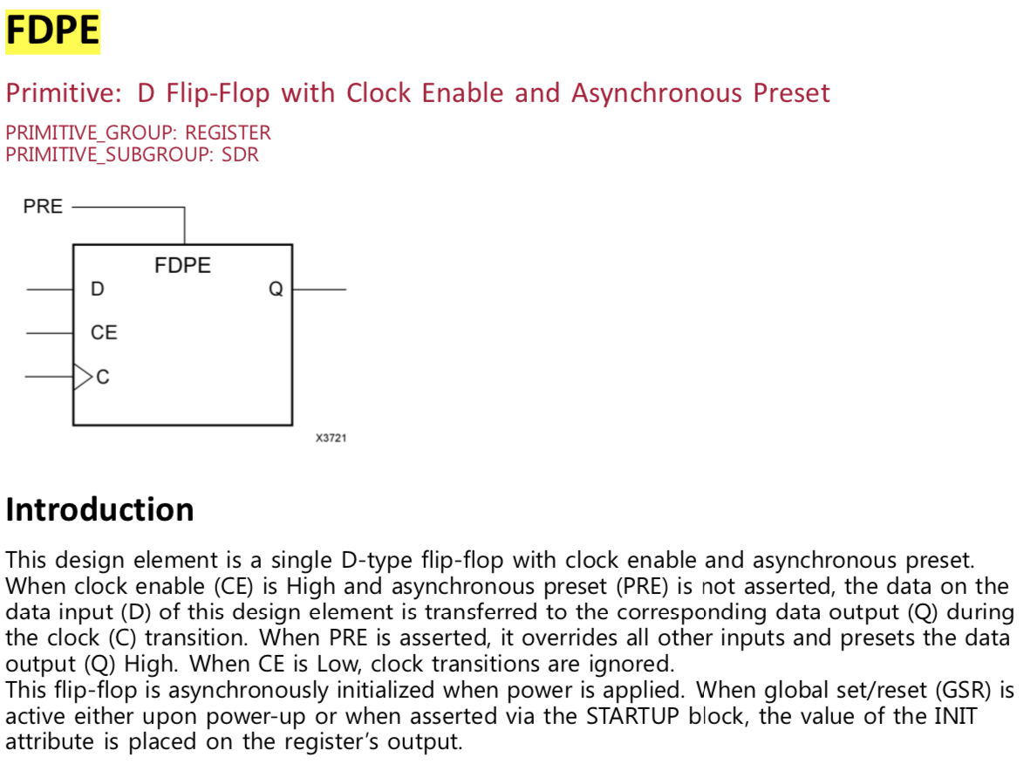
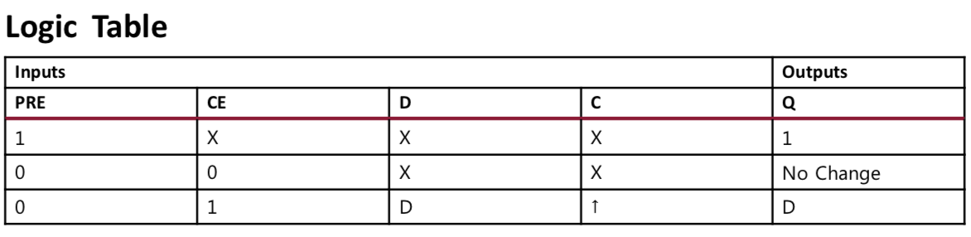
FDPE

Slide 88
CSR in RTIO

Slide 89
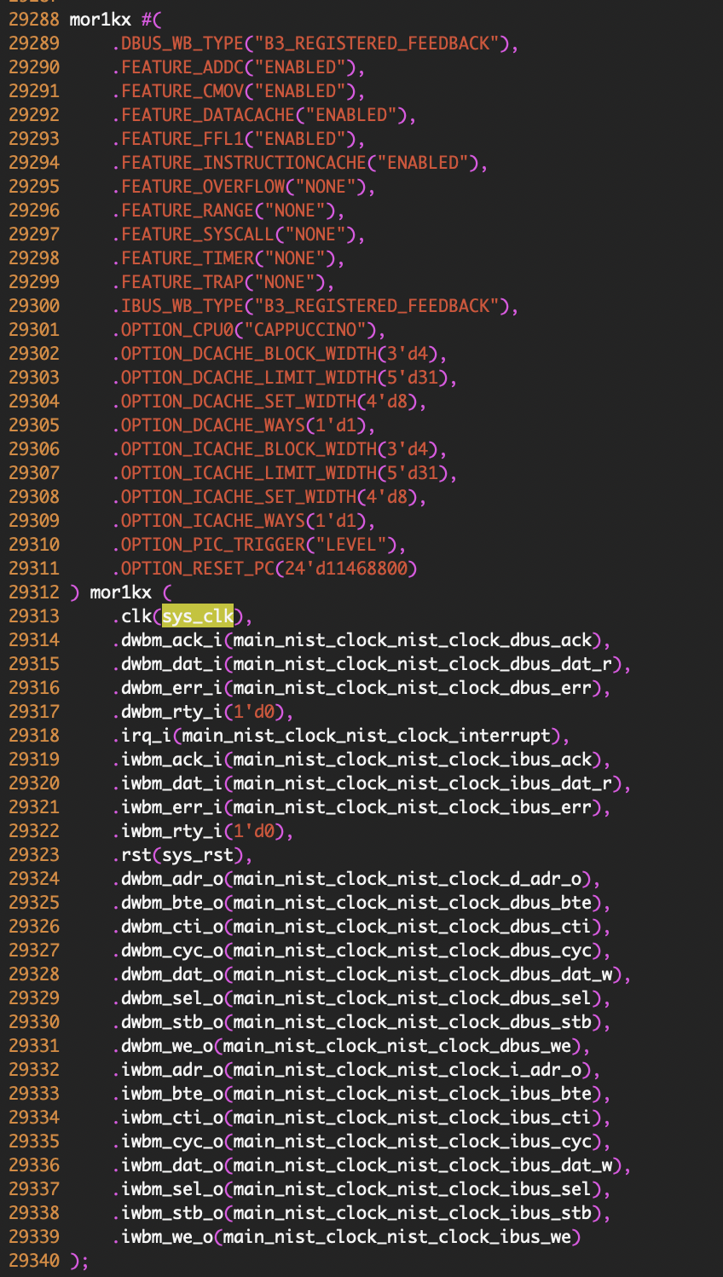

Slide 90
CSRStatus
(sequence_error_channel)
status[15:0]
rsys_clk
0
CSRStatus
(busy_channel)
EQUAL?
[3:0]
status[15:0]
rsys_clk
1
CSRStatus
(collision_channel)
EQUAL?
[3:0]
status[15:0]
rsys_clk
CSR
(reset)
[0:0]
16
w
r
re
EQUAL?
mor1kx
[13:9]
main_nist_clock_nist_clock_interface_adr[13:0]
sys_clk
CSR
(reset_phy)
[0:0]
iwbm_dat_i
2
[31:2]
dwbm_dat_i
w
r
re
1 0
[31:2]
iwbm_adr_o
EQUAL?
builder_comb_rhs_array_muxed62[29:0]
[3:0]
dwbm_adr_o
CSR
(async_error)
iwbm_we_o
builder_comb_rhs_array_muxed67
sys_clk
1 0
dwbm_we_o
w[2:0]
r[2:0]
re
iwbm_dat_o
dwbm_dat_o
main_nist_clock_nist_clock_interface_dat_w[7:0]
sys_clk
builder_comb_rhs_array_muxed63[31:0]
sys_clk
1 0
[2:0]
[7:0]

Slide 91
input control
CSRStatus
(sequence_error_channel)
builder_nist_clock_csrbank9_sequence_error_channel1_w
status[15:0]
rsys_clk
builder_nist_clock_csrbank9_sequence_error_channel0_w
CSRStatus
(busy_channel)
builder_nist_clock_csrbank9_busy_channel1_w
status[15:0]
builder_nist_clock_csrbank9_busy_channel0_w
rsys_clk
output
builder_nist_clock_csrbank9_collision_channel1_w
CSRStatus
(collision_channel)
builder_nist_clock_csrbank9_collision_channel0_w
status[15:0]
rsys_clk
main_rtio_core_reset_w
main_rtio_core_reset_phy_w
CSR
(reset)
main_rtio_core_async_error_w
w
r
re
builder_nist_clock_csrbank9_sel
builder_nist_clock_interface9_bank_bus_adr
builder_comb_rhs_array_muxed62
mor1kx
16
CSR
(reset_phy)
EQUAL?
iwbm_dat_i
[13:9]
sys_clk
[31:2]
dwbm_dat_i
w
r
re
main_nist_clock_nist_clock_interface_adr[13:0]
1 0
[31:2]
iwbm_adr_o
dwbm_adr_o
CSR
(async_error)
builder_comb_rhs_array_muxed62[29:0]
iwbm_we_o
dwbm_we_o
w[2:0]
r[2:0]
re
iwbm_dat_o
dwbm_dat_o

Slide 92
Input Control

Slide 93
builder_nist_clock_interface0_bank_bus_dat_r
sys_clk
builder_nist_clock_csrbank9_sequence_error_channel1_w
builder_nist_clock_interface1_bank_bus_dat_r
sys_clk
builder_nist_clock_interface2_bank_bus_dat_r
sys_clk
builder_nist_clock_csrbank9_sequence_error_channel0_w
builder_nist_clock_interface3_bank_bus_dat_r
sys_clk
builder_nist_clock_interface4_bank_bus_dat_r
sys_clk
builder_nist_clock_csrbank9_busy_channel1_w
builder_nist_clock_interface5_bank_bus_dat_r
sys_clk
builder_nist_clock_interface6_bank_bus_dat_r
sys_clk
builder_nist_clock_csrbank9_busy_channel0_w
builder_nist_clock_interface7_bank_bus_dat_r
sys_clk
1 0
builder_nist_clock_interface8_bank_bus_dat_r
sys_clk
sys_clk
builder_nist_clock_csrbank9_collision_channel1_w
MUX
sys_clk
main_nist_clock_nist_clock_interface_dat_r
builder_nist_clock_interface9_bank_bus_dat_r
sys_clk
builder_nist_clock_interface10_bank_bus_dat_r
sys_clk
builder_nist_clock_csrbank9_collision_channel0_w
builder_nist_clock_interface11_bank_bus_dat_r
builder_nist_clock_interface12_bank_bus_dat_r
sys_clk
main_rtio_core_reset_w
builder_nist_clock_interface13_bank_bus_dat_r
sys_clk
builder_nist_clock_interface14_bank_bus_dat_r
sys_clk
main_rtio_core_reset_phy_w
sys_clk
builder_nist_clock_interface15_bank_bus_dat_r
sys_clk
main_rtio_core_async_error_w
builder_nist_clock_interface16_bank_bus_dat_r
builder_nist_clock_interface17_bank_bus_dat_r
sys_clk
builder_nist_clock_interface9_bank_bus_adr[13:0]
builder_nist_clock_csrbank9_sel
builder_comb_rhs_array_muxed62[29:0]

Slide 94
[26]
x32
[27]
[28]
main_nist_clock_nist_clock_sram_bus_dat_r[31:0]
sys_clk
[26]
x32
[27]
[28]
main_nist_clock_nist_clock_interface_dat_r[7:0]
sys_clk
[27]
x32
output
[28]
main_nist_clock_nist_clock_wb_sdram_dat_r [31:0]
sys_clk
[26]
x32
[27]
[28]
main_nist_clock_spiflash_bus_dat_r [31:0]
sys_clk
[27]
x32
[28]
main_bus_dat_r [31:0]
sys_clk
[26]
x32
[27]
sys_clk
[28]
main_mailbox_i1_dat_r [31:0]
builder_comb_rhs_array_muxed62[29:0]

Slide 95
Verilog Code
27710 if (builder_nist_clock_csrbank9_sel) begin
27711 case (builder_nist_clock_interface9_bank_bus_adr[3:0])
27712 1'd0: begin
27713 builder_nist_clock_interface9_bank_bus_dat_r <= main_rtio_core_reset_w;
27714 end
27715 1'd1: begin
27716 builder_nist_clock_interface9_bank_bus_dat_r <= main_rtio_core_reset_phy_w;
27717 end
27718 2'd2: begin
27719 builder_nist_clock_interface9_bank_bus_dat_r <= main_rtio_core_async_error_w;
27720 end
27721 2'd3: begin
27722 builder_nist_clock_interface9_bank_bus_dat_r <= builder_nist_clock_csrbank9_collision_channel1_w;
27723 end
27724 3'd4: begin
27725 builder_nist_clock_interface9_bank_bus_dat_r <= builder_nist_clock_csrbank9_collision_channel0_w;
27726 end
27727 3'd5: begin
27728 builder_nist_clock_interface9_bank_bus_dat_r <= builder_nist_clock_csrbank9_busy_channel1_w;
27729 end
27730 3'd6: begin
27731 builder_nist_clock_interface9_bank_bus_dat_r <= builder_nist_clock_csrbank9_busy_channel0_w;
27732 end
27733 3'd7: begin
27734 builder_nist_clock_interface9_bank_bus_dat_r <= builder_nist_clock_csrbank9_sequence_error_channel1_w;
27735 end
27736 4'd8: begin
27737 builder_nist_clock_interface9_bank_bus_dat_r <= builder_nist_clock_csrbank9_sequence_error_channel0_w;
27738 end
27739 endcase
27740 end

Slide 96
Verilog Code
15498 assign main_nist_clock_nist_clock_interface_dat_r = (((((((((((((((((builder_nist_clock_interface0_bank_bus_dat_r | builder_nist_clock_interface1_bank_bus_dat_r) | builder_nist_clock_interface2_bank_bus_dat_r) | builder_nist_clock_interface3_bank_bus_dat_r) | builder_nist_clock_interface4_bank_bus_dat_r) | builder_nist_clock_interface5_bank_bus_dat_r) | builder_nist_clock_interface6_bank_bus_dat_r) | builder_nist_clock_interface7_bank_bus_dat_r) | builder_nist_clock_interface8_bank_bus_dat_r) | builder_nist_clock_interface9_bank_bus_dat_r) | builder_nist_clock_interface10_bank_bus_dat_r) | builder_nist_clock_interface11_bank_bus_dat_r) | builder_nist_clock_interface12_bank_bus_dat_r) | builder_nist_clock_interface13_bank_bus_dat_r) | builder_nist_clock_interface14_bank_bus_dat_r) | builder_nist_clock_interface15_bank_bus_dat_r) | builder_nist_clock_interface16_bank_bus_dat_r) | builder_nist_clock_interface17_bank_bus_dat_r);

Slide 97
Verilog Code
14451 assign builder_nist_clock_shared_dat_r =
(((((({32{builder_nist_clock_slave_sel_r[0]}} & main_nist_clock_nist_clock_sram_bus_dat_r) |
({32{builder_nist_clock_slave_sel_r[1]}} & main_nist_clock_nist_clock_bus_wishbone_dat_r)) |
({32{builder_nist_clock_slave_sel_r[2]}} & main_nist_clock_nist_clock_wb_sdram_dat_r)) |
({32{builder_nist_clock_slave_sel_r[3]}} & main_nist_clock_spiflash_bus_dat_r)) |
({32{builder_nist_clock_slave_sel_r[4]}} & main_bus_dat_r)) |
({32{builder_nist_clock_slave_sel_r[5]}} & main_mailbox_i1_dat_r));
14389 always @(*) begin
14390 builder_nist_clock_slave_sel <= 6'd0;
14391 builder_nist_clock_slave_sel[0] <= (((1'd1 & (~builder_nist_clock_shared_adr[27])) & (~builder_nist_clock_shared_adr[28])) & builder_nist_clock_shared_adr[26]);
14392 builder_nist_clock_slave_sel[1] <= (((1'd1 & (~builder_nist_clock_shared_adr[26])) & builder_nist_clock_shared_adr[27]) & builder_nist_clock_shared_adr[28]);
14393 builder_nist_clock_slave_sel[2] <= ((1’d1 & (~builder_nist_clock_shared_adr[27])) & builder_nist_clock_shared_adr[28]);
14394 builder_nist_clock_slave_sel[3] <= (((1'd1 & (~builder_nist_clock_shared_adr[26])) & (~builder_nist_clock_shared_adr[27])) & (~builder_nist_clock_shared_adr[28]));
14395 builder_nist_clock_slave_sel[4] <= ((1’d1 & (~builder_nist_clock_shared_adr[28])) & builder_nist_clock_shared_adr[27]);
14396 builder_nist_clock_slave_sel[5] <= (((1'd1 & builder_nist_clock_shared_adr[26]) & builder_nist_clock_shared_adr[27]) & builder_nist_clock_shared_adr[28]);

Slide 99
==========================================================================

Slide 100
CSRStatus
(sequence_error_channel)
status[15:0]
rsys_clk
CSRStatus
(busy_channel)
status[15:0]
rsys_clk
CSRStatus
(collision_channel)
status[15:0]
rsys_clk
CSR
(reset_phy)
w
r
re
mor1kx
CSR
(reset)
w
r
re
iwbm_adr_o
dwbm_adr_o
CSR
(async_error)
iwbm_adr_we_o
dwbm_we_o
w[2:0]
r[2:0]
re
main_nist_clock_nist_clock_interface_dat_w[7:0]
sys_clk
builder_comb_rhs_array_muxed63[31:0]
sys_clk
1 0
iwbm_dat_o
[7:0]
dwbm_dat_o
[2:0]

Slide 101
mor1kx
CSRStatus
(sequence_error_channel)
status[15:0]
rsys_clk
CSRStatus
(busy_channel)
dwbm_adr_o
iwbm_adr_o
status[15:0]
rsys_clk
iwbm_adr_we_o
dwbm_we_o
CSRStatus
(collision_channel)
status[15:0]
rsys_clk
16
CSR
(reset_phy)
builder_nist_clock_csrbank9_sel
builder_nist_clock_interface9_bank_bus_adr[13:0]
main_nist_clock_nist_clock_bus_wishbone_adr[29:0]
w
r
re
EQUAL?
main_nist_clock_nist_clock_interface_adr[13:0]
sys_clk
[13:9]
builder_nist_clock_shared_adr[29:0]
CSR
(reset)
w
r
re
builder_nist_clock_interface9_bank_bus_we
builder_comb_rhs_array_muxed62[29:0]
main_nist_clock_nist_clock_interface_we
CSR
(async_error)
16
builder_comb_rhs_array_muxed67
sys_clk
main_nist_clock_nist_clock_ibus_adr[29:0]
1 0
main_nist_clock_nist_clock_i_adr_o[31:2]
w[2:0]
r[2:0]
re
EQUAL?
main_nist_clock_nist_clock_tmpu_adr[29:0]
[3:0]
main_nist_clock_nist_clock_ibus_we
1 0
main_nist_clock_nist_clock_dbus_adr[29:0]
main_nist_clock_nist_clock_tmpu_we
main_nist_clock_nist_clock_dbus_we
main_nist_clock_nist_clock_d_adr_o[31:2]

Slide 102
mor1kx
CSRStatus
(sequence_error_channel)
status[15:0]
rsys_clk
CSRStatus
(busy_channel)
dwbm_adr_o
iwbm_adr_o
status[15:0]
rsys_clk
iwbm_adr_we_o
dwbm_we_o
CSRStatus
(collision_channel)
status[15:0]
rsys_clk
CSR
(reset_phy)
w
r
re
main_rtio_core_async_error_r[2:0]
[2:0]
builder_nist_clock_interface9_bank_bus_dat_w[7:0]
CSR
(reset)
main_nist_clock_nist_clock_interface_dat_w[7:0]
sys_clk
main_nist_clock_nist_clock_bus_wishbone_dat_w[31:0]
w
r
re
builder_nist_clock_shared_dat_w[31:0]
CSR
(async_error)
builder_comb_rhs_array_muxed63[31:0]
sys_clk
w[2:0]
r[2:0]
re
main_nist_clock_nist_clock_ibus_dat_w[31:0]
1 0
main_nist_clock_nist_clock_tmpu_dat_w[31:0]
main_nist_clock_nist_clock_dbus_dat_w[31:0]

Slide 103
CSRStatus
(sequence_error_channel)
status[15:0]
rsys_clk
CSRStatus
(busy_channel)
status[15:0]
input
control
rsys_clk
CSRStatus
(collision_channel)
main_rtio_core_reset_w
status[15:0]
rsys_clk
main_rtio_core_reset_phy_w
main_rtio_core_async_error_w
builder_nist_clock_csrbank9_collision_channel1_w
builder_nist_clock_csrbank9_collision_channel0_w
output
CSR
(reset_phy)
builder_nist_clock_csrbank9_busy_channel1_w
w
r
re
builder_nist_clock_csrbank9_busy_channel0_w
CSR
(reset)
builder_nist_clock_csrbank9_sequence_error_channel1_w
w
r
re
builder_nist_clock_csrbank9_sequence_error_channel0_w
CSR
(async_error)
builder_nist_clock_csrbank9_sel
w[2:0]
r[2:0]
re
builder_nist_clock_interface9_bank_bus_adr

Slide 105
node1 < node2
nondata_difference
~valid
channel[4:0]
input[node1]
payload
valid
channel[4:0]
1 0
1 0
replace_occured
fine_ts[2:0]
nondata_replace_occured
address[1:0]
seqn[11:0]
data[31:0]
1 0
1 0
input[node2]
payload
valid
channel[4:0]
SLT
replace_occured
fine_ts[2:0]
nondata_replace_occured
address[1:0]
seqn[11:0]
data[31:0]
SLT
~valid
channel[4:0]

